Slide 1
Java Script
Module 2

Slide 2
Content
Introduction
What can we do?
Where to write?
Generate output

Slide 3
Introduction
JavaScript is the world's most popular programming language.
JavaScript is the programming language of the Web.
JavaScript is easy to learn.
JavaScript is one of the 3 languages all web developers must learn:
HTML to define the content of web pages
CSS to specify the layout of web pages
JavaScript to program the behavior of web pages

Slide 4
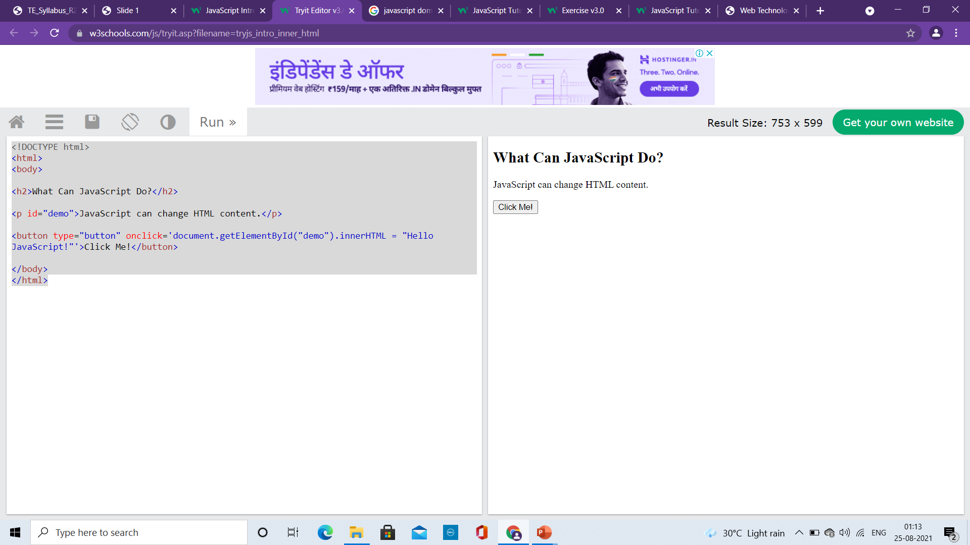
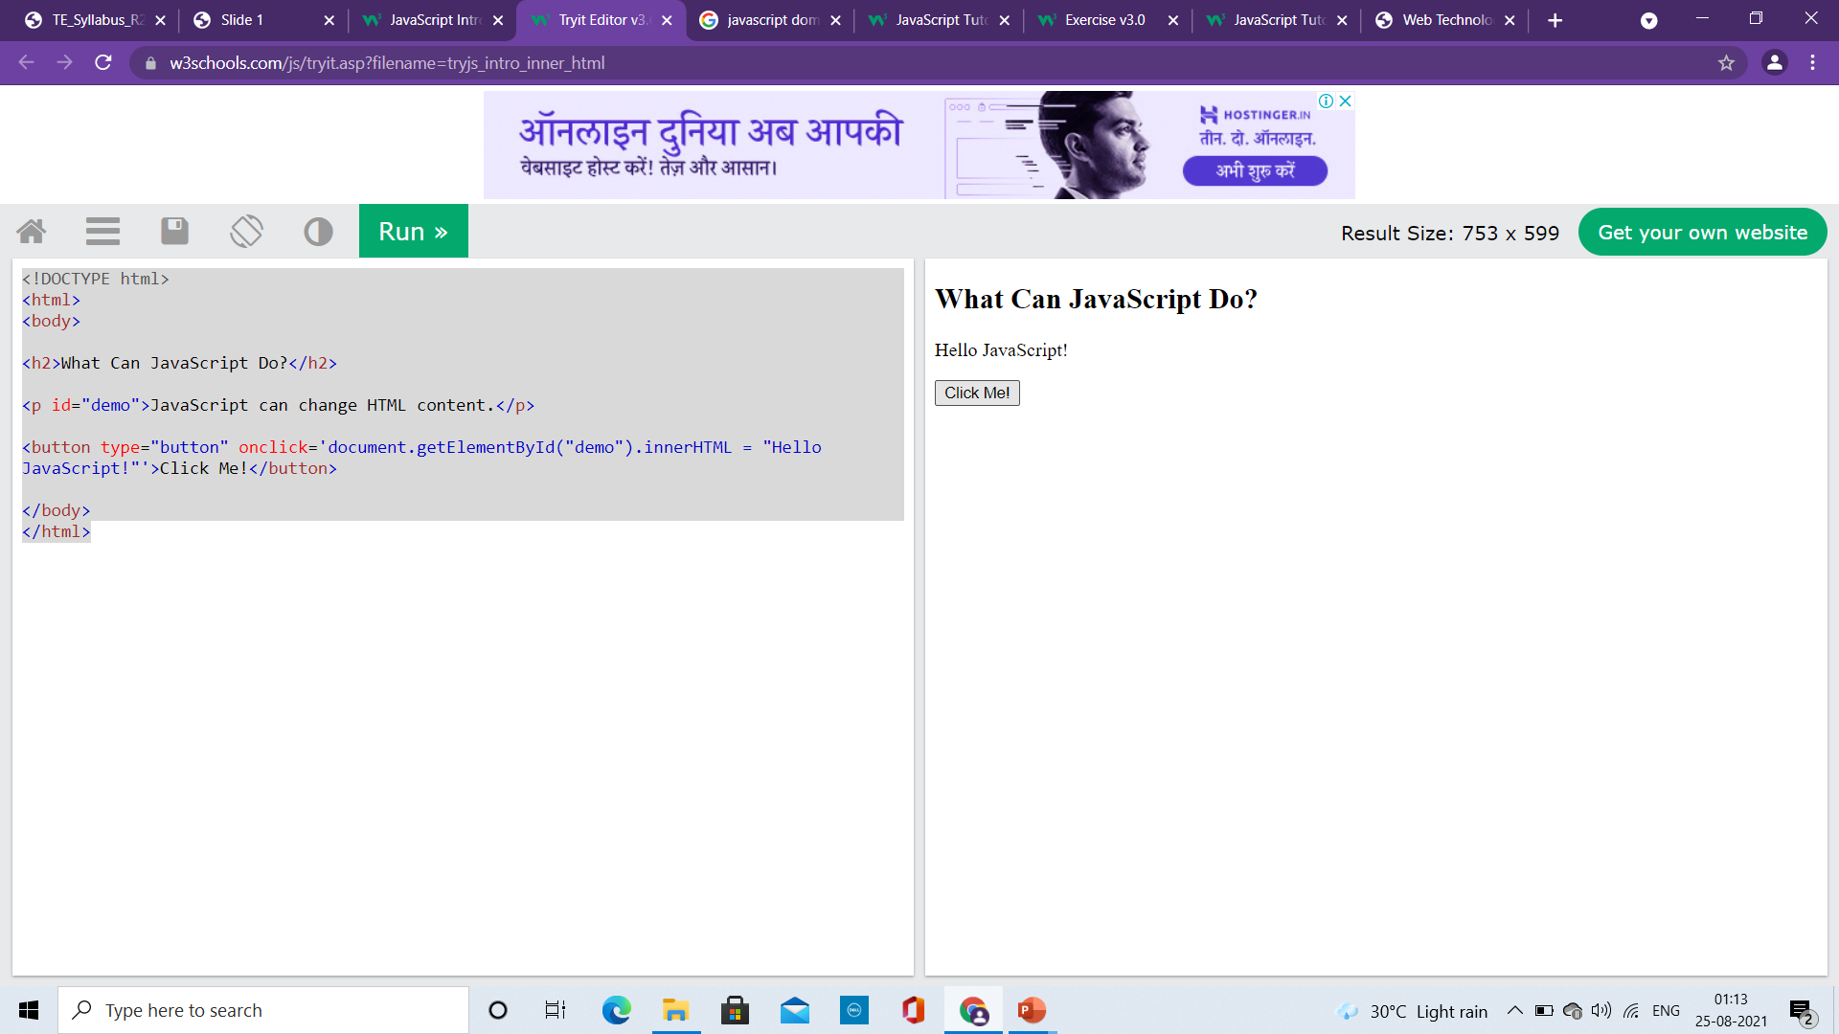
What JavaScript can do?
Change HTML Style (CSS)
<!DOCTYPE html>
<html>
<body>
<h2>What Can JavaScript Do?</h2>
<p id="demo">JavaScript can change HTML content.</p>
<button type="button" onclick="document.getElementById('demo').innerHTML = 'Hello JavaScript!'">Click Me!</button>
</body>
</html>

Slide 5
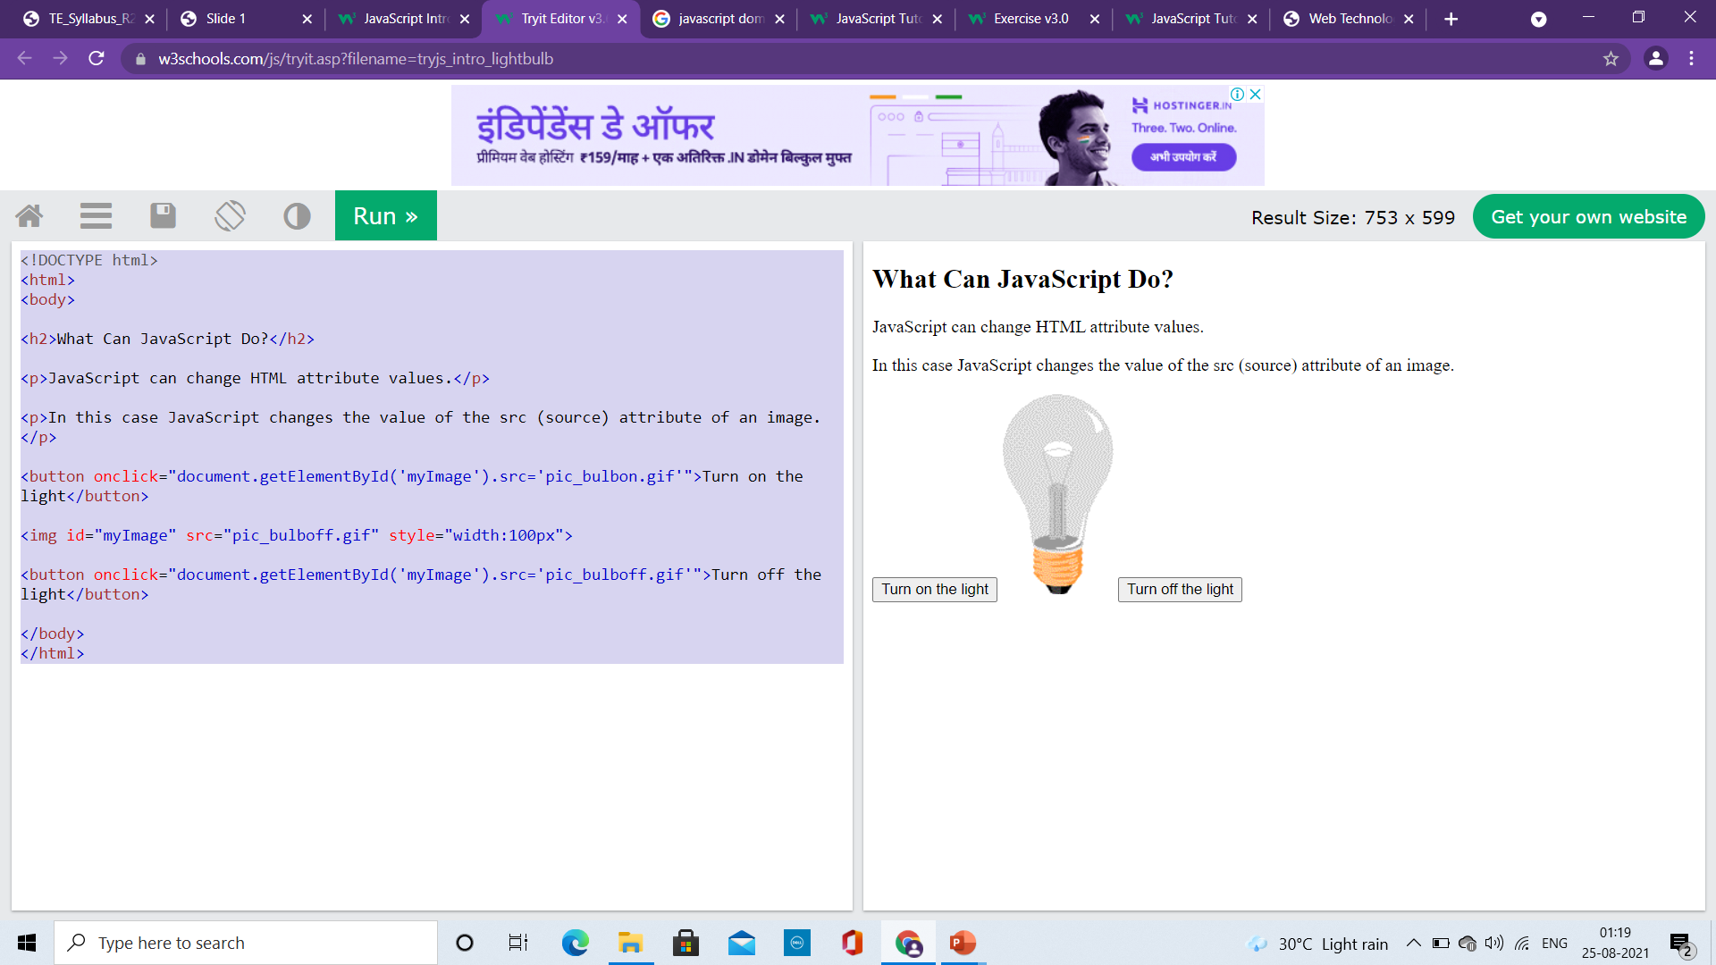
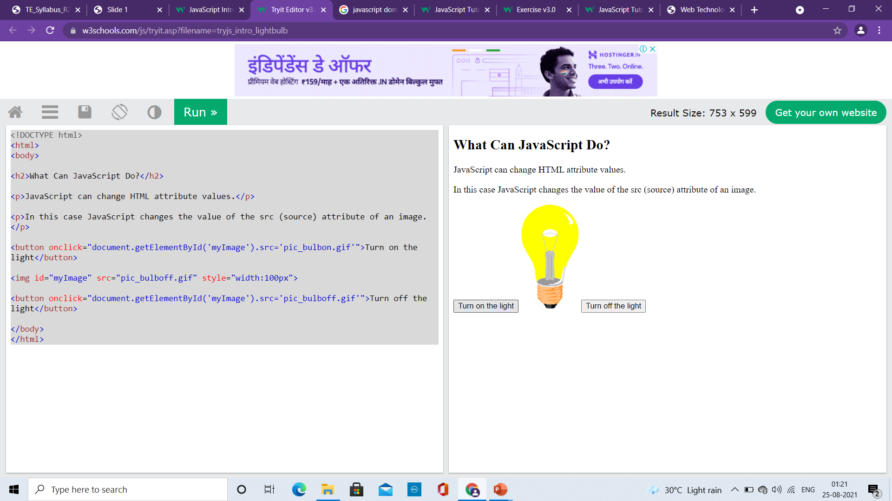
What JavaScript can do?
Change HTML Attribute Values
<!DOCTYPE html>
<html>
<body>
<h2>What Can JavaScript Do?</h2>
<p>JavaScript can change HTML attribute values.</p>
<p>In this case JavaScript changes the value of the src (source) attribute of an image.</p>
<button onclick="document.getElementById('myImage').src='pic_bulbon.gif'">Turn on the light</button>
<img id="myImage" src="pic_bulboff.gif" style="width:100px">
<button onclick="document.getElementById('myImage').src='pic_bulboff.gif'">Turn off the light</button>
</body>
</html>

Slide 6
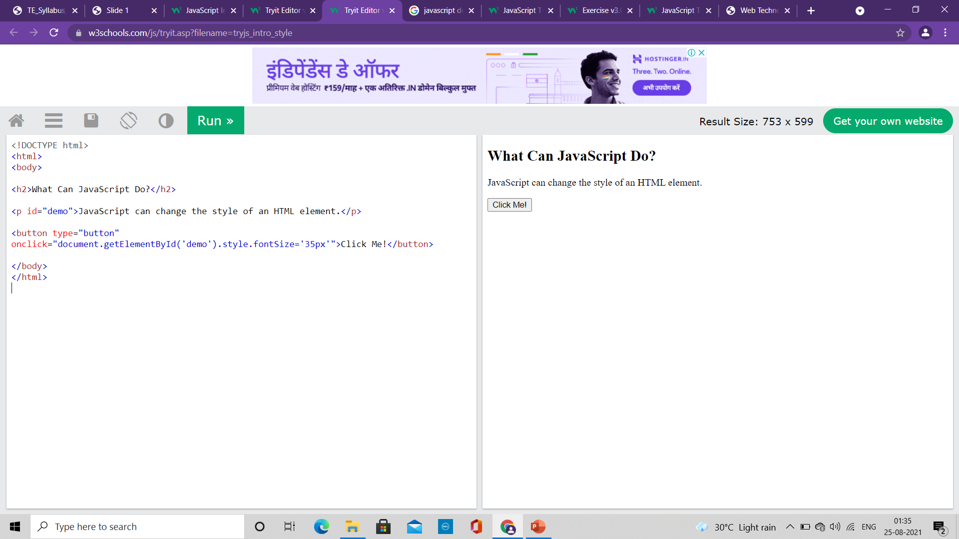
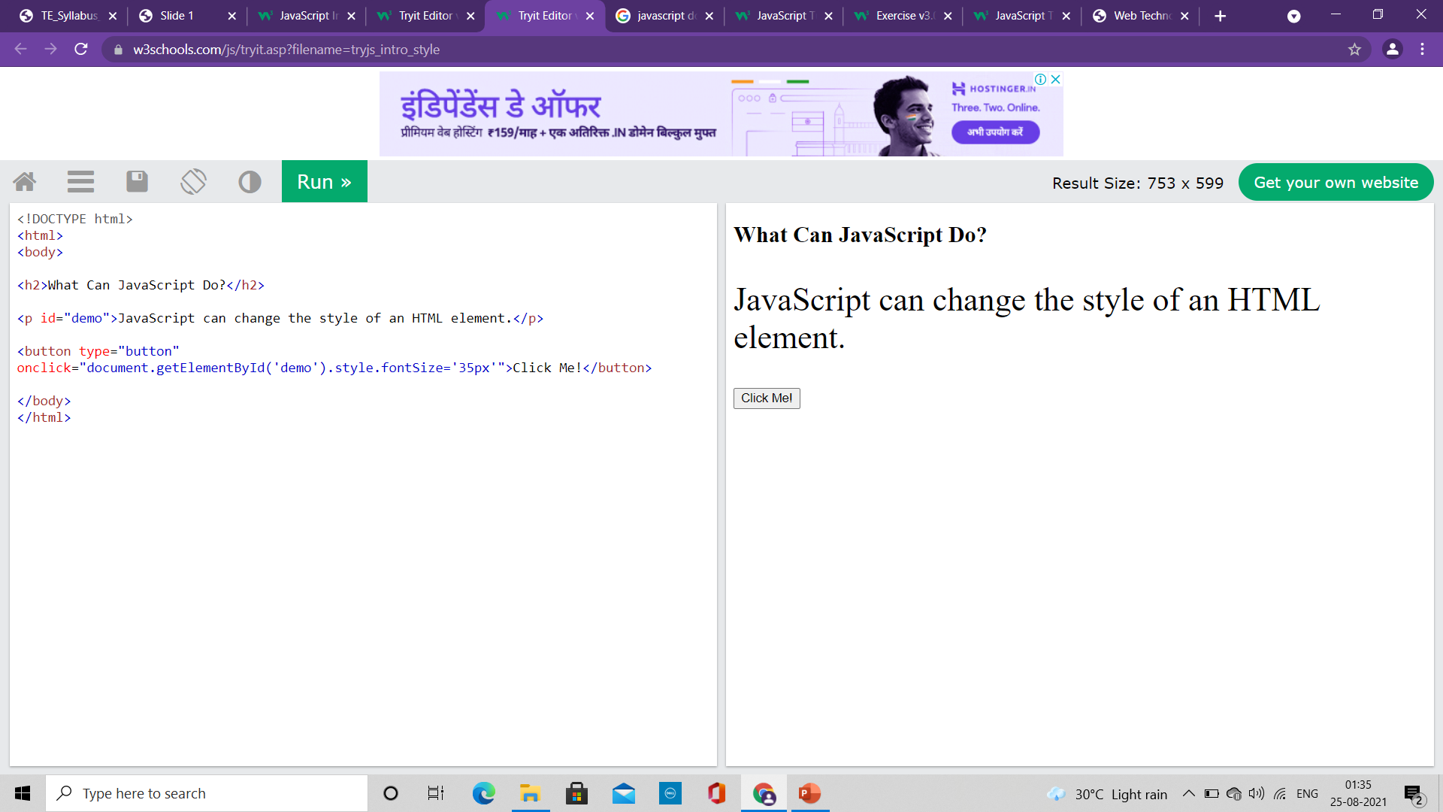
What JavaScript can do?
Change HTML Style (CSS)
<!DOCTYPE html>
<html>
<body>
<h2>What Can JavaScript Do?</h2>
<p id="demo">JavaScript can change the style of an HTML element.</p>
<button type="button" onclick="document.getElementById('demo').style.fontSize='35px'">Click Me!</button>
</body>
</html>

Slide 7
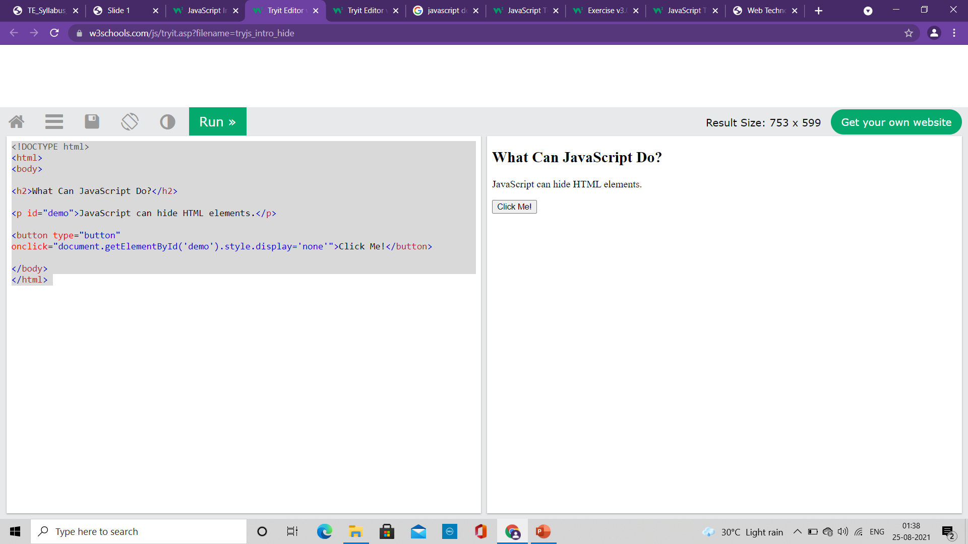

What JavaScript can do?
Hide HTML Elements
<!DOCTYPE html>
<html>
<body>
<h2>What Can JavaScript Do?</h2>
<p id="demo">JavaScript can hide HTML elements.</p>
<button type="button" onclick="document.getElementById('demo').style.display='none'">Click Me!</button>
</body>
</html>

Slide 8
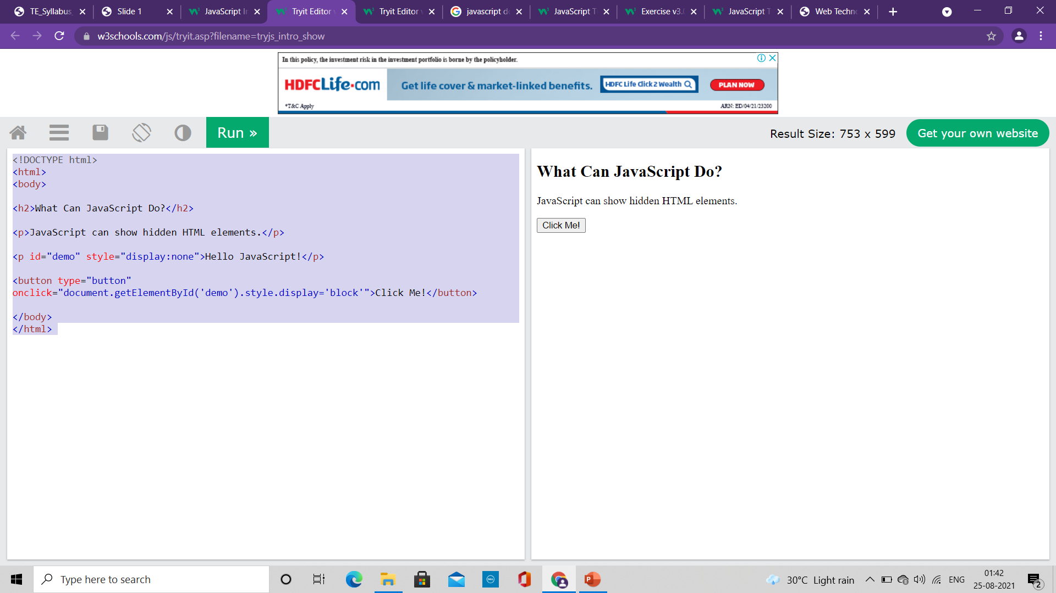
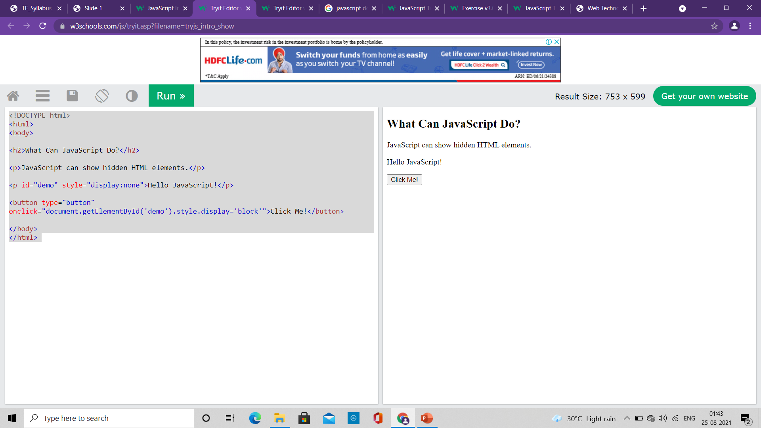
What JavaScript can do?
Show HTML Elements
<!DOCTYPE html>
<html>
<body>
<h2>What Can JavaScript Do?</h2>
<p>JavaScript can show hidden HTML elements.</p>
<p id="demo" style="display:none">Hello JavaScript!</p>
<button type="button" onclick="document.getElementById('demo').style.display='block'">Click Me!</button>
</body>
</html>

Slide 9
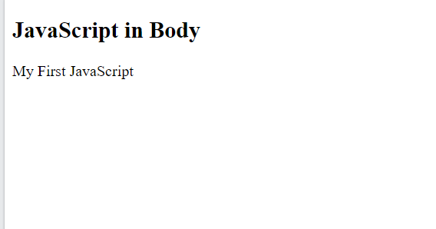
Where to write JavaScript code?
The <script> Tag
In HTML, JavaScript code is inserted between <script> and </script> tags.
We can place any number of scripts in an HTML document.
Scripts can be placed in the <body>, or in the <head> section of an HTML page, or in both.
<!DOCTYPE html>
<html>
<body>
<h2>JavaScript in Body</h2>
<p id="demo"></p>
<script>
document.getElementById("demo").innerHTML = "My First JavaScript";
</script>
</body>
</html>

Slide 10
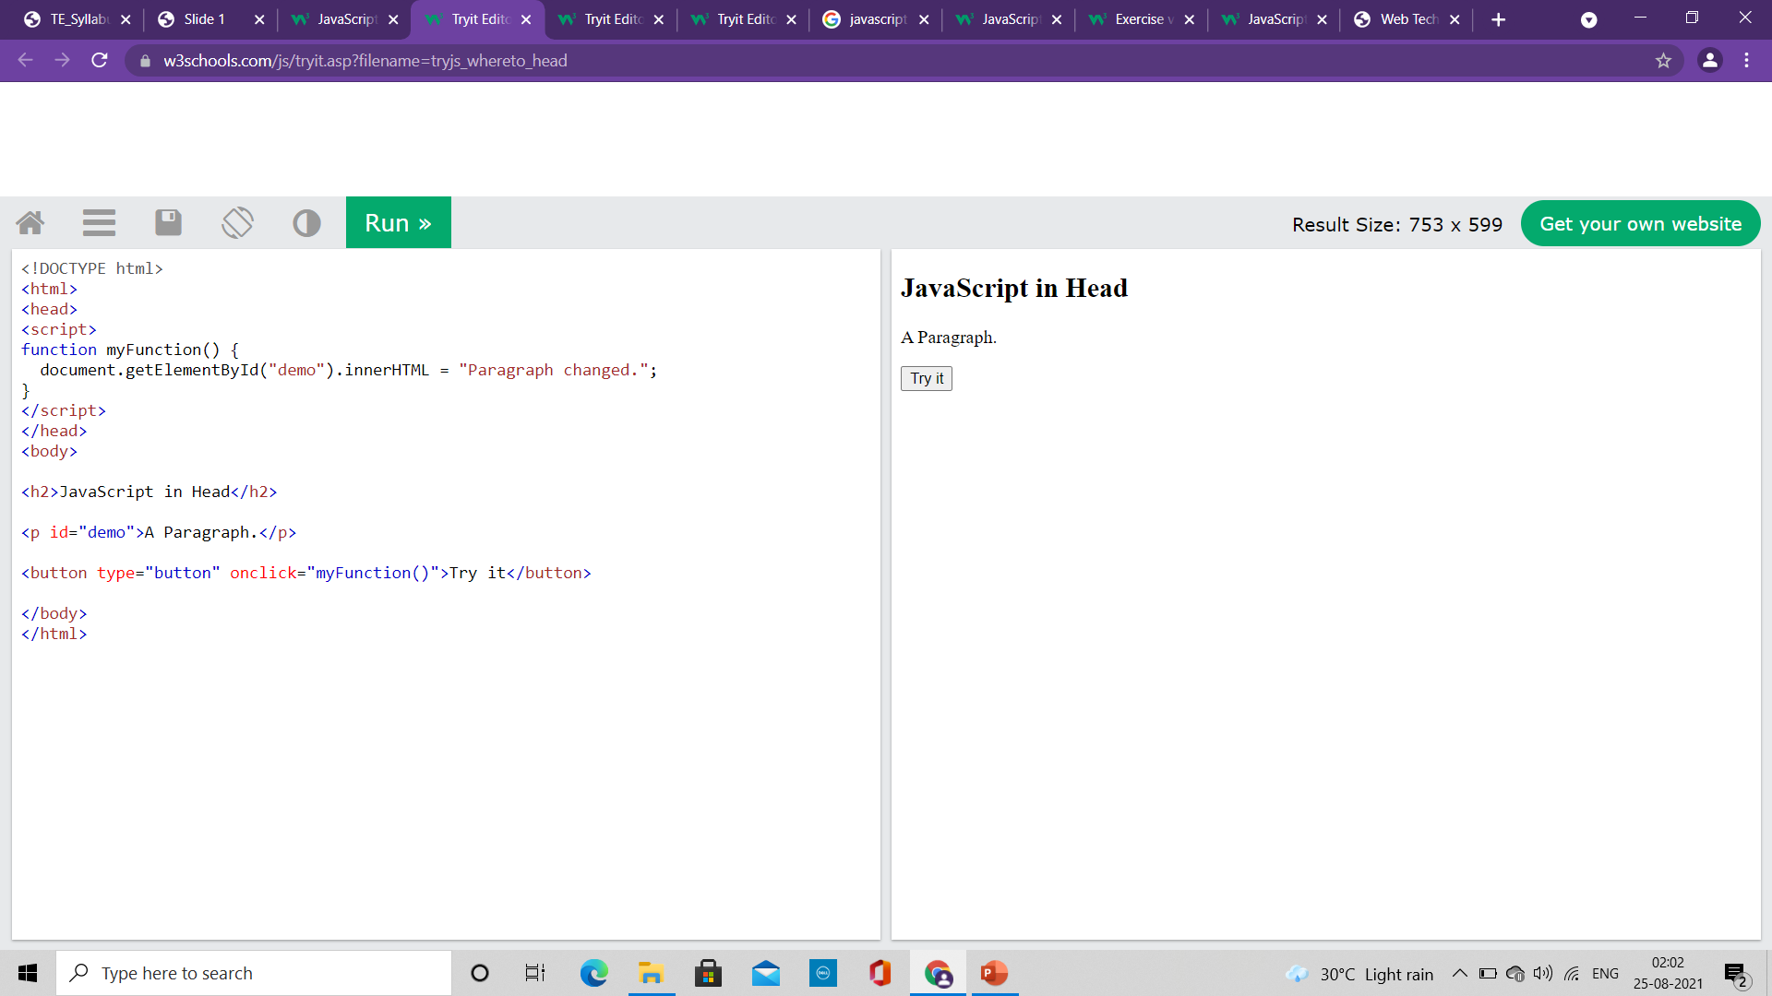

Where to write JavaScript code?
<!DOCTYPE html>
<html>
<head>
<script>
function myFunction() {
document.getElementById("demo").innerHTML = "Paragraph changed.";
}
</script>
</head>
<body>
<h2>JavaScript in Head</h2>
<p id="demo">A Paragraph.</p>
<button type="button" onclick="myFunction()">Try it</button>
</body>
</html>
A JavaScript function
It is a block of JavaScript code, that can be executed when "called" for.
Example: a function can be called when an event occurs, like when the user clicks a button.
Script is written in the head

Slide 11
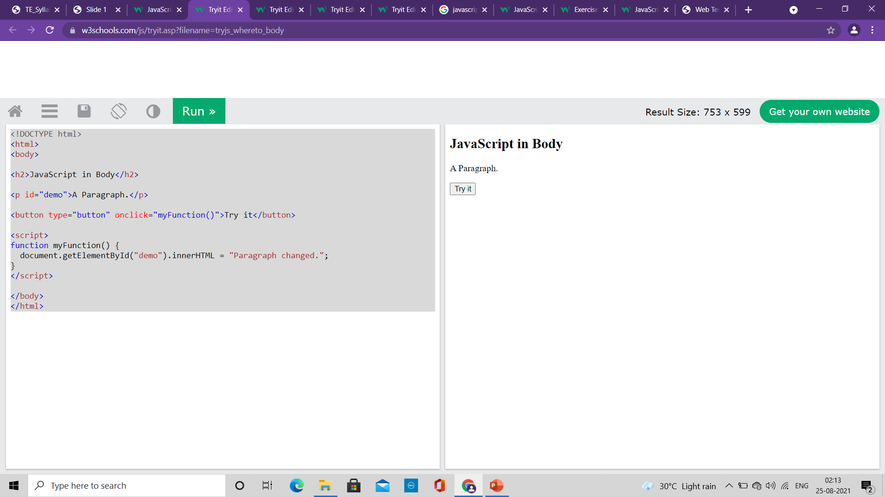

Where to write JavaScript code?
<!DOCTYPE html>
<html>
<body>
<h2>JavaScript in Body</h2>
<p id="demo">A Paragraph.</p>
<button type="button" onclick="myFunction()">Try it</button>
<script>
function myFunction() {
document.getElementById("demo").innerHTML = "Paragraph changed.";
}
</script>
</body>
</html>
A JavaScript function
It is a block of JavaScript code, that can be executed when "called" for.
Example: a function can be called when an event occurs, like when the user clicks a button.
Script is written in the body

Slide 12
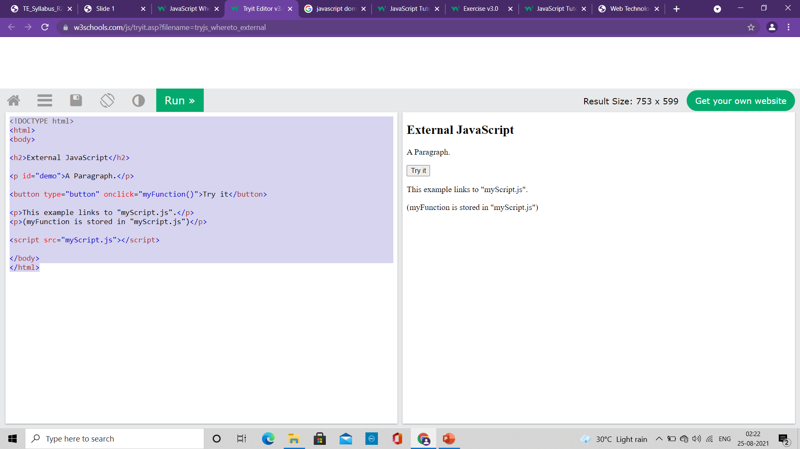
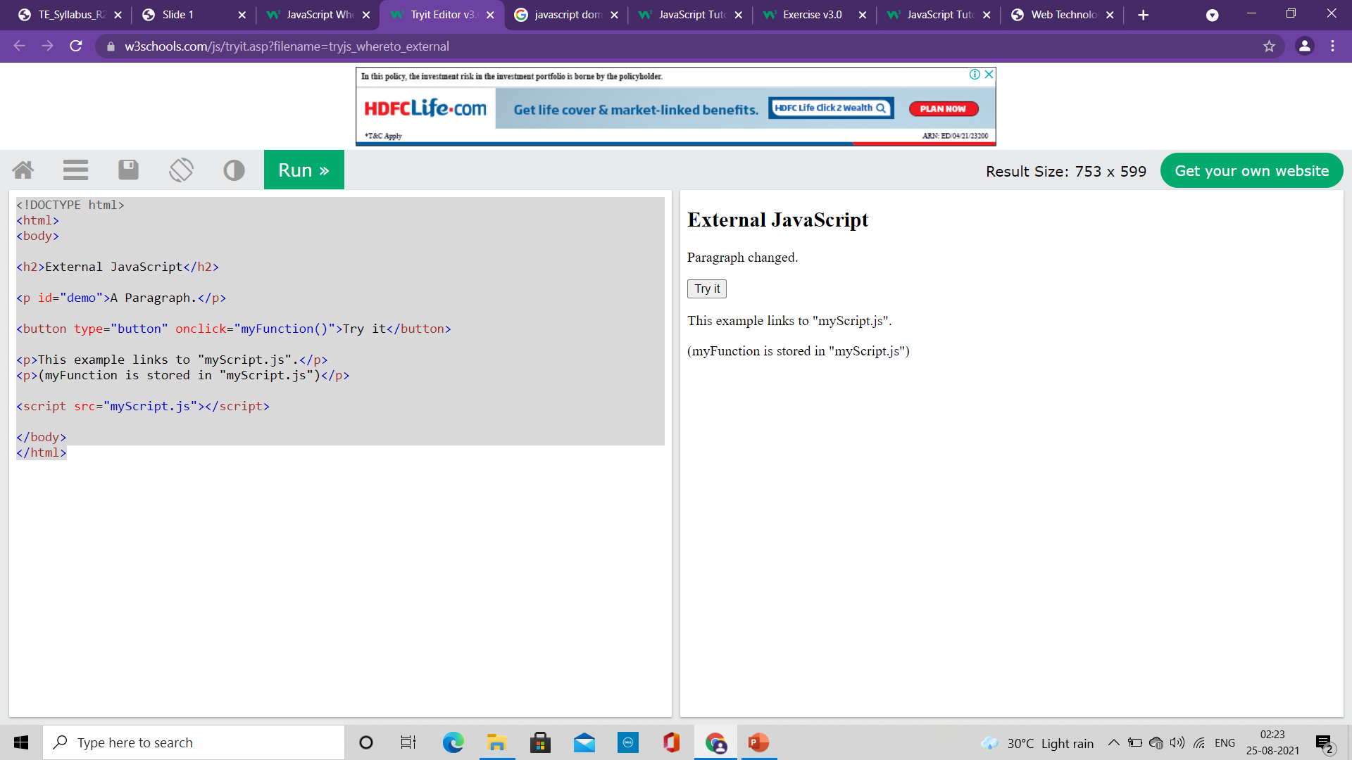
Where to write JavaScript code?
External JavaScript
Scripts can also be placed in external files
External scripts are practical when the same code is used in many different web pages.
JavaScript files have the file extension .js.
To use an external script, put the name of the script file in the src (source) attribute of a <script> tag
You can place an external script reference in <head> or <body> as you like.
The script will behave as if it was located exactly where the <script> tag is located.
External scripts cannot contain <script> tags.
<!DOCTYPE html>
<html>
<body>
<h2>External JavaScript</h2>
<p id="demo">A Paragraph.</p>
<button type="button" onclick="myFunction()">Try it</button>
<p>This example links to "myScript.js".</p>
<p>(myFunction is stored in "myScript.js")</p>
<script src="myScript.js"></script>
</body>
</html>
function myFunction() { document.getElementById("demo").innerHTML = "Paragraph changed."; }
myScript.js

Slide 13
Where to write JavaScript code?
External JavaScript
Placing scripts in external files has some advantages:
It separates HTML and code
It makes HTML and JavaScript easier to read and maintain
Cached JavaScript files can speed up page loads
To add several script files to one page - use several script tags:
<script src="myScript1.js"></script> <script src="myScript2.js"></script>

Slide 14
Where to write JavaScript code?
External References
An external script can be referenced in 3 different ways:
With a full URL (a full web address)
Example: <script src="https://www.w3schools.com/js/myScript.js"></script>
With a file path (like /js/)
Example: <script src="/js/myScript.js"></script>
Without any path
Example: <script src="myScript.js"></script>

Slide 15
JavaScript Output
JavaScript can "display" data in different ways:
Writing into an HTML element, using innerHTML.
Writing into the HTML output using document.write().
Writing into an alert box, using window.alert().
Writing into the browser console, using console.log().

Slide 16
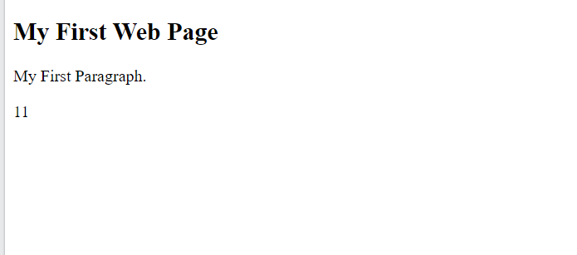
JavaScript Output
<!DOCTYPE html> <html> <body> <h1>My First Web Page</h1> <p>My First Paragraph</p> <p id="demo"></p> <script> document.getElementById("demo").innerHTML = 5 + 6; </script> </body> </html>
innerHTML
To access an HTML element, JavaScript can use the document.getElementById(id) method.
The id attribute defines the HTML element. The innerHTML property defines the HTML content:

Slide 17

JavaScript Output
<!DOCTYPE html> <html> <body> <h1>My First Web Page</h1> <p>My first paragraph.</p> <script> document.write(5 + 6); </script> </body> </html>
Document.write()
For testing purposes, it is convenient to use document.write()
Using document.write() after an HTML document is loaded, will delete all existing HTML

Slide 18
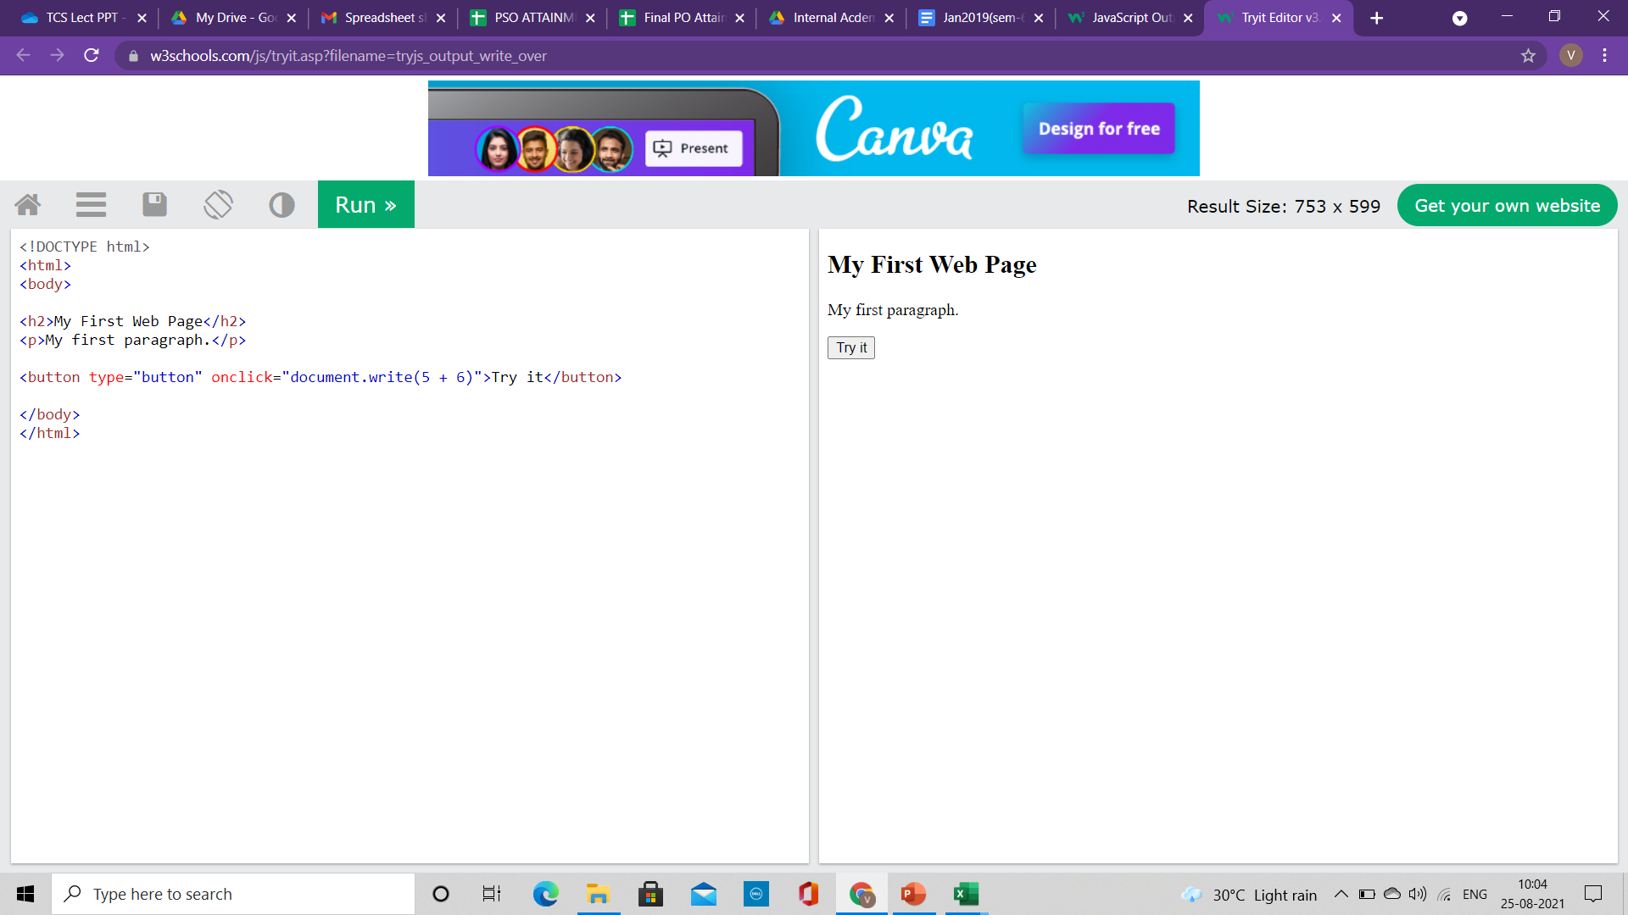
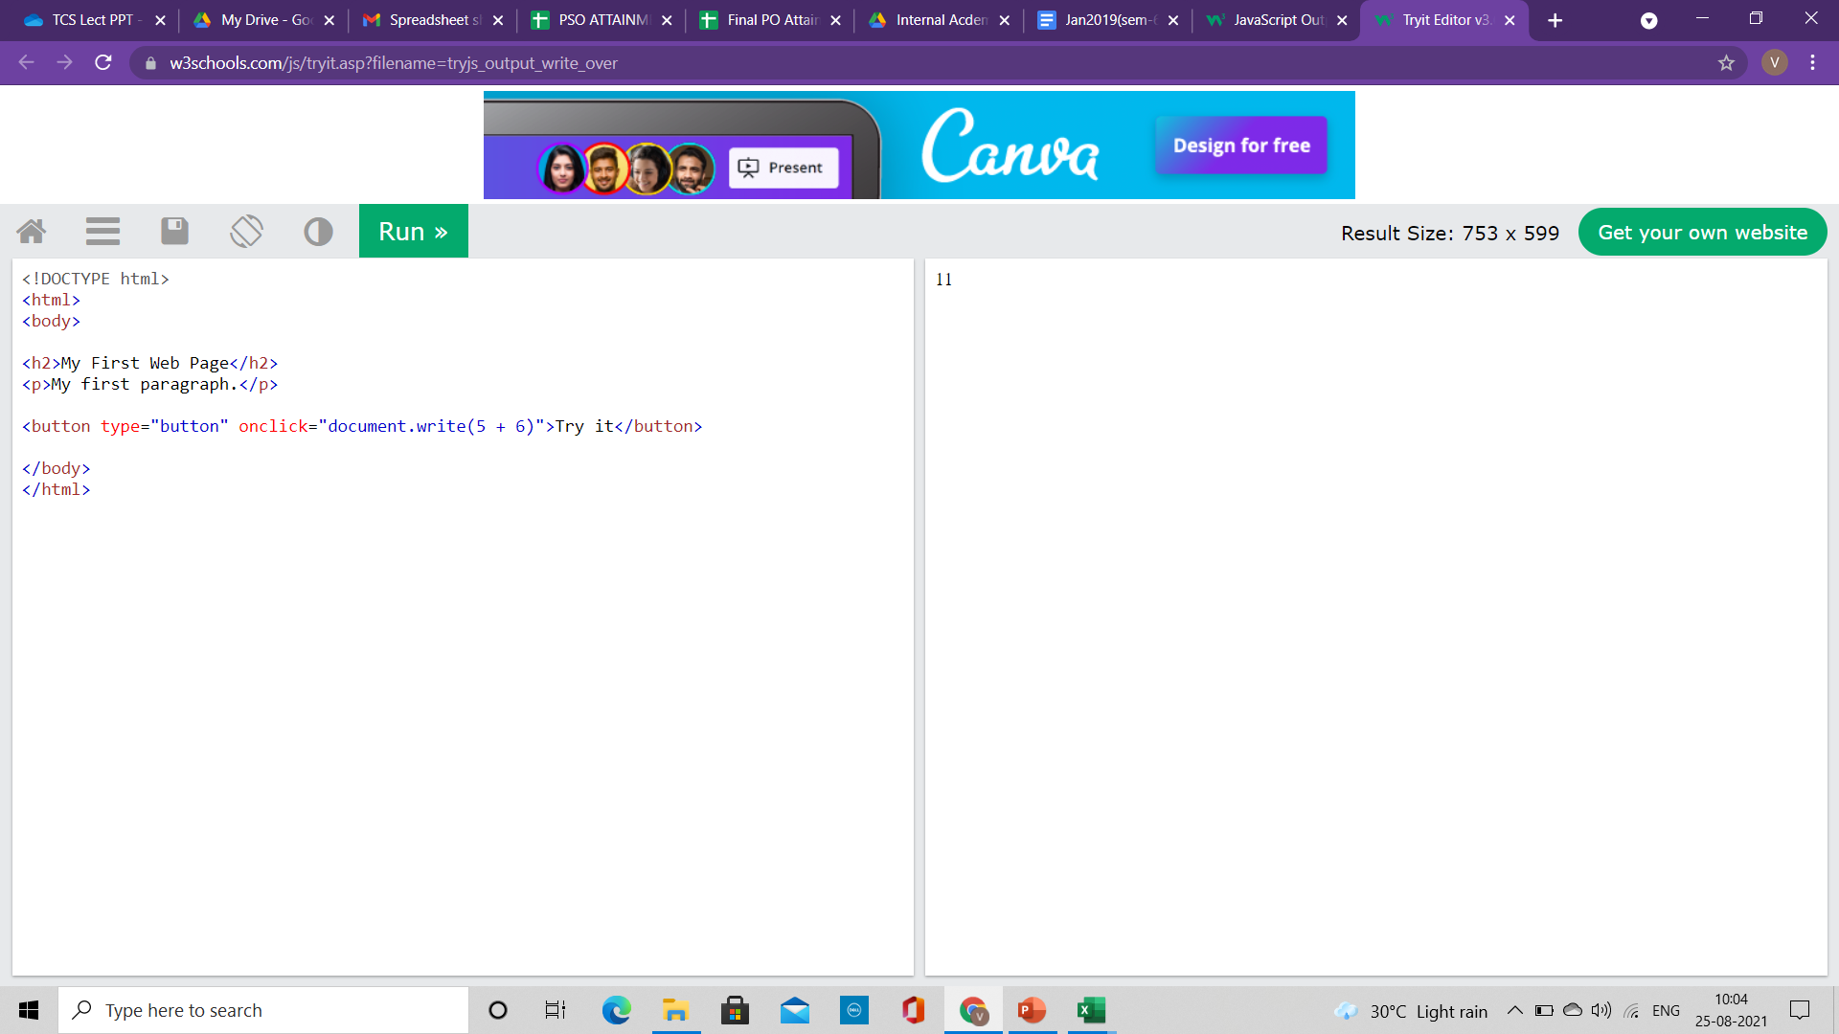
JavaScript Output
<!DOCTYPE html> <html> <body> <h1>My First Web Page</h1> <p>My first paragraph.</p> <button type="button" onclick="document.write(5 + 6)">Try it</button> </body> </html>
Document.write()
For testing purposes, it is convenient to use document.write()
Using document.write() after an HTML document is loaded, will delete all existing HTML

Slide 19
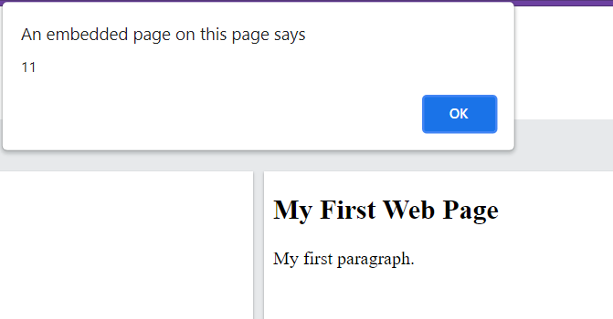
JavaScript Output
<!DOCTYPE html> <html> <body> <h1>My First Web Page</h1> <p>My first paragraph.</p> <script> window.alert(5 + 6); </script> </body> </html>
windows.alert()
We can use an alert box to display data
We can skip the window keyword.
In JavaScript, the window object is the global scope object,
It means that variables, properties, and methods by default belong to the window object.
This also means that specifying the window keyword is optional

Slide 20
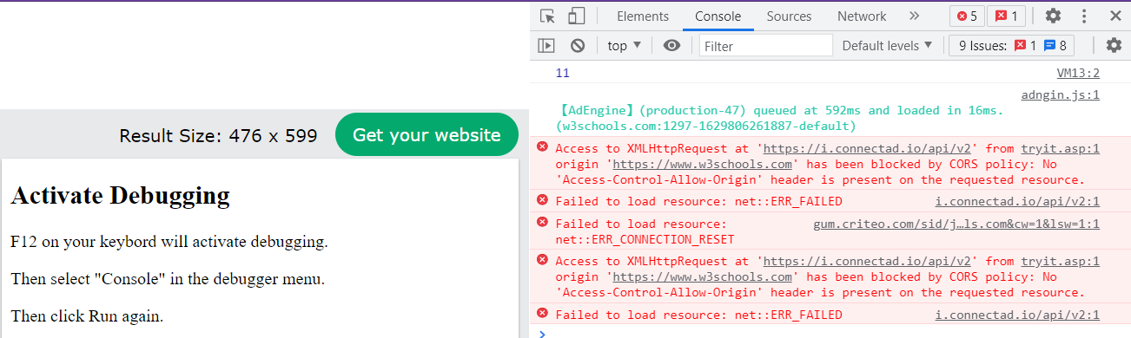
JavaScript Output
<!DOCTYPE html>
<html>
<body>
<h2>Activate Debugging</h2>
<p>F12 on your keyboard will activate debugging.</p>
<p>Then select "Console" in the debugger menu.</p>
<p>Then click Run again.</p>
<script>
console.log(5 + 6);
</script>
</body>
</html>
Console.log()
For debugging purposes, we can call the console.log() method in the browser to display data

Slide 21
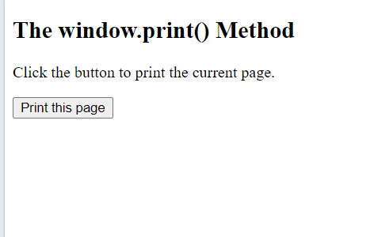
JavaScript Output
<!DOCTYPE html>
<html>
<body>
<h2>The window.print() Method</h2>
<p>Click the button to print the current page.</p>
<button onclick="window.print()">Print this page</button>
</body>
</html>
windows.print()
JavaScript does not have any print object or print methods.
You cannot access output devices from JavaScript.
The only exception is that you can call the window.print() method in the browser to print the content of the current window.

Slide 22
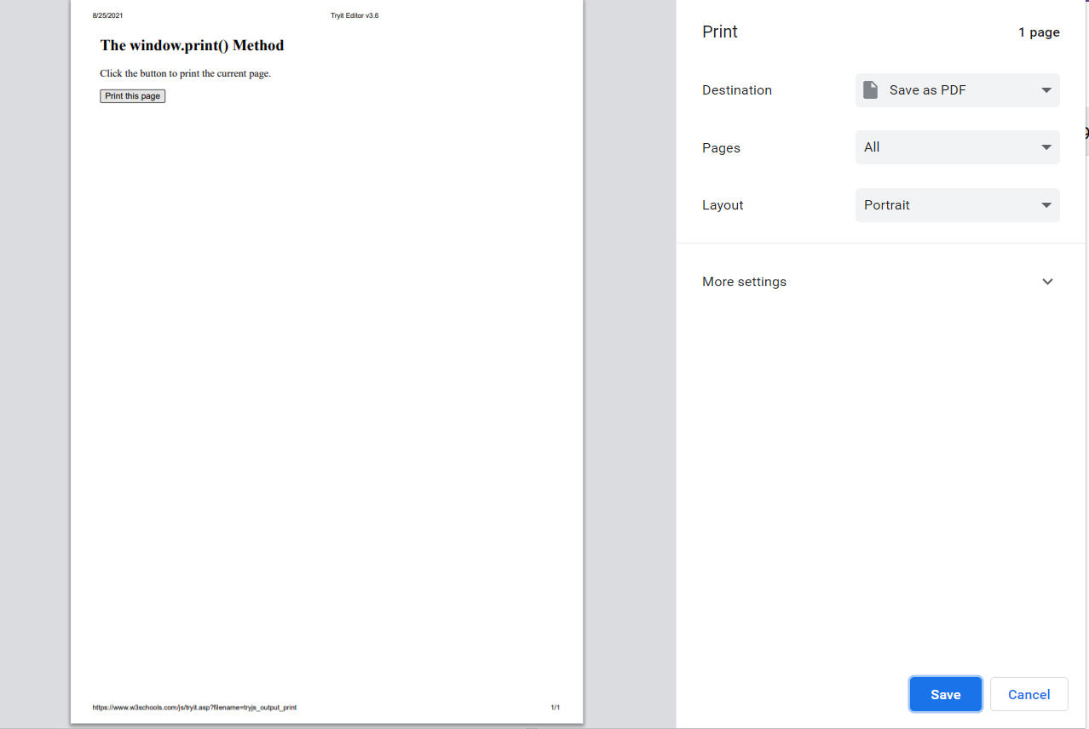
JavaScript Output
<!DOCTYPE html>
<html>
<body>
<h2>The window.print() Method</h2>
<p>Click the button to print the current page.</p>
<button onclick="window.print()">Print this page</button>
</body>
</html>
windows.print()
JavaScript does not have any print object or print methods.
You cannot access output devices from JavaScript.
The only exception is that you can call the window.print() method in the browser to print the content of the current window.

Slide 23
Java Script
Module 2

Slide 24
Content
Statements
Syntax
Function
Objects

Slide 25
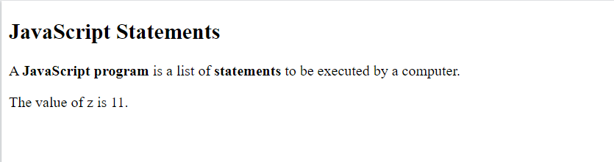
JavaScript Statements
<!DOCTYPE html>
<html>
<body>
<h2>JavaScript Statements</h2>
<p>A <b>JavaScript program</b> is a list of <b>statements</b> to be executed by a computer.</p>
<p id="demo"></p>
<script>
let x, y, z; // Statement 1
x = 5; // Statement 2
y = 6; // Statement 3
z = x + y; // Statement 4
document.getElementById("demo").innerHTML = "The value of z is " + z + ".";
</script>
</body>
</html>
A computer program is a list of "instructions" to be "executed" by a computer.
In a programming language, these programming instructions are called statements.
A JavaScript program is a list of programming statements.
In HTML, JavaScript programs are executed by the web browser.
JavaScript statements are composed of:
Values
Operators
Expressions
Keywords
Comments.

Slide 26
JavaScript Statements
Most JavaScript programs contain many JavaScript statements.
The statements are executed, one by one, in the same order as they are written.
JavaScript programs (and JavaScript statements) are often called JavaScript code
Semicolons:
Semicolons separate JavaScript statements.
Add a semicolon at the end of each executable statement
When separated by semicolons, multiple statements on one line are allowed
Ending statements with semicolon is not required, but highly recommended
<!DOCTYPE html>
<html>
<body>
<h2>JavaScript Statements</h2>
<p>A <b>JavaScript program</b> is a list of <b>statements</b> to be executed by a computer.</p>
<p id="demo"></p>
<script>
let x, y, z; // Statement 1
x = 5; // Statement 2
y = 6; // Statement 3
z = x + y; // Statement 4
document.getElementById("demo").innerHTML = "The value of z is " + z + ".";
</script>
</body>
</html>

Slide 27
JavaScript Statements
JavaScript White Space
JavaScript ignores multiple spaces.
We can add white space to your script to make it more readable
A good practice is to put spaces around operators ( = + - * / )
JavaScript Line Length and Line Breaks
For best readability, programmers often like to avoid code lines longer than 80 characters.
If a JavaScript statement does not fit on one line, the best place to break it is after an operator:
<!DOCTYPE html>
<html>
<body>
<h2>JavaScript Statements</h2>
<p>A <b>JavaScript program</b> is a list of <b>statements</b> to be executed by a computer.</p>
<p id="demo"></p>
<script>
let x, y, z; // Statement 1
x = 5; // Statement 2
y = 6; // Statement 3
z = x + y; // Statement 4
document.getElementById("demo").innerHTML = "The value of z is " + z + ".";
</script>
</body>
</html>

Slide 28
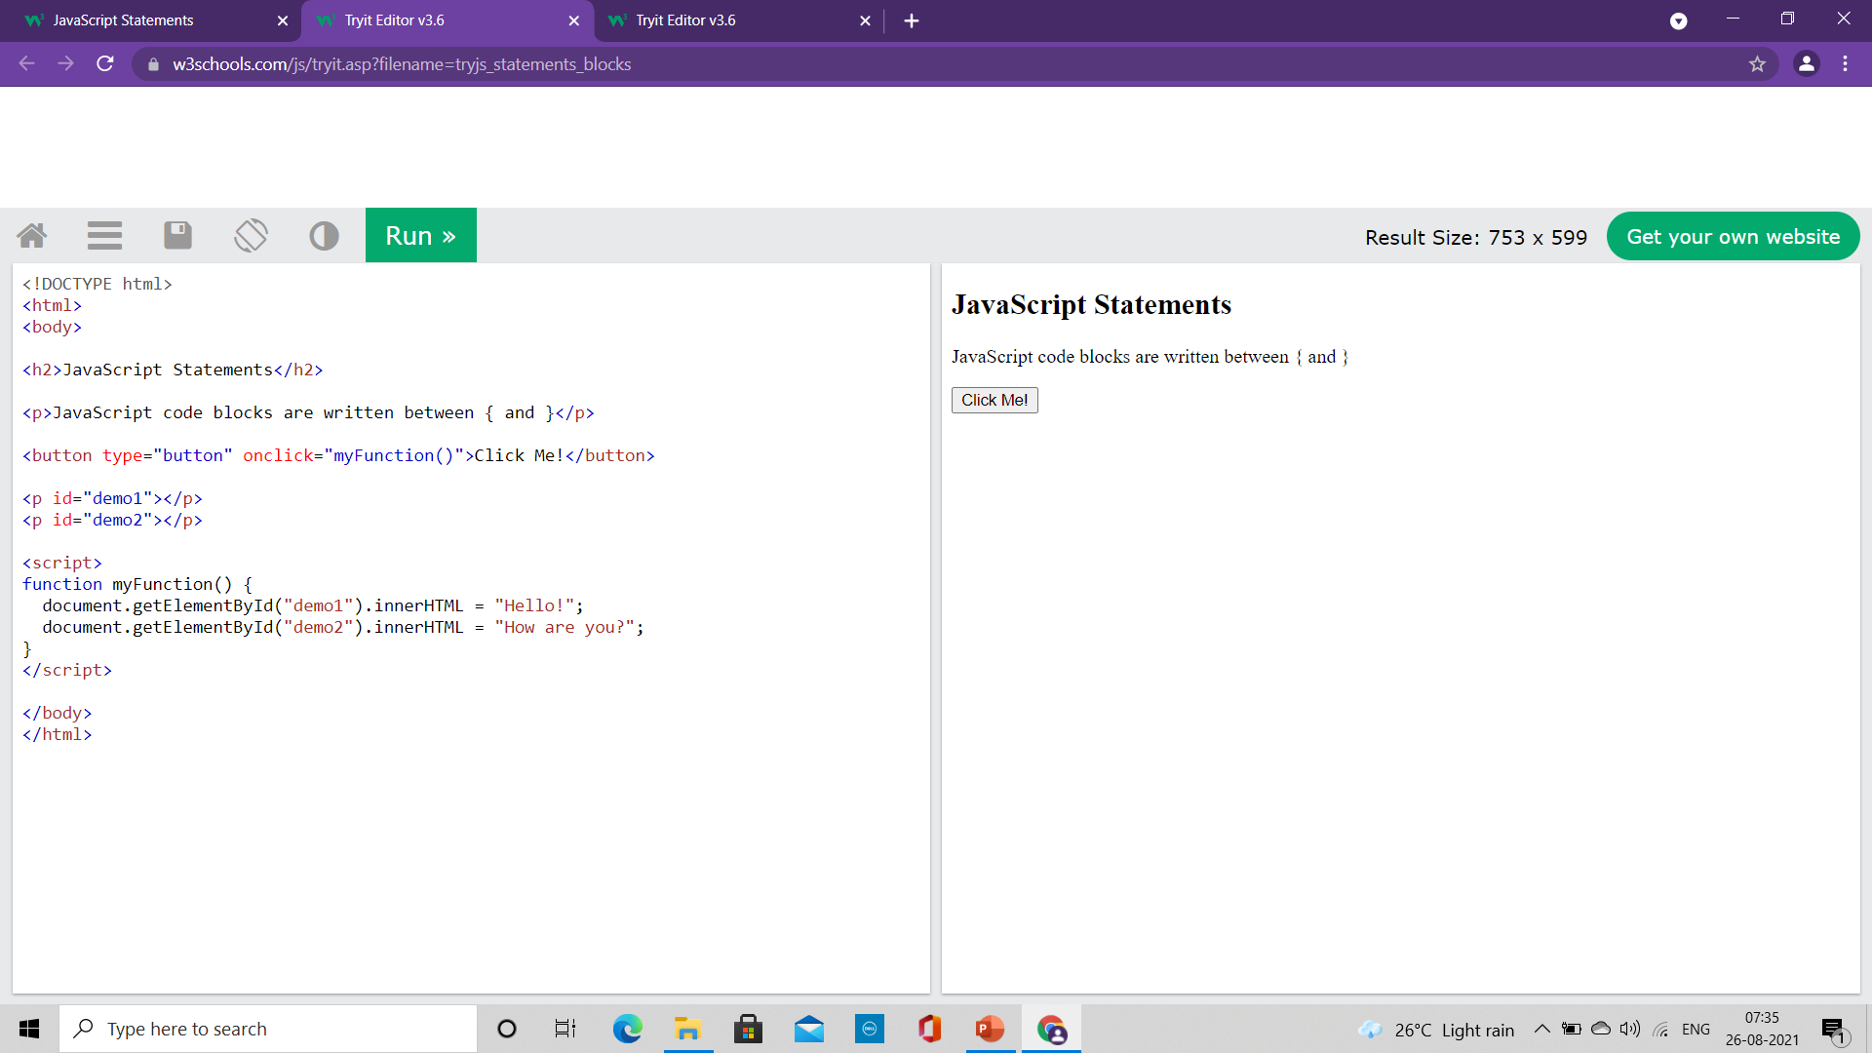
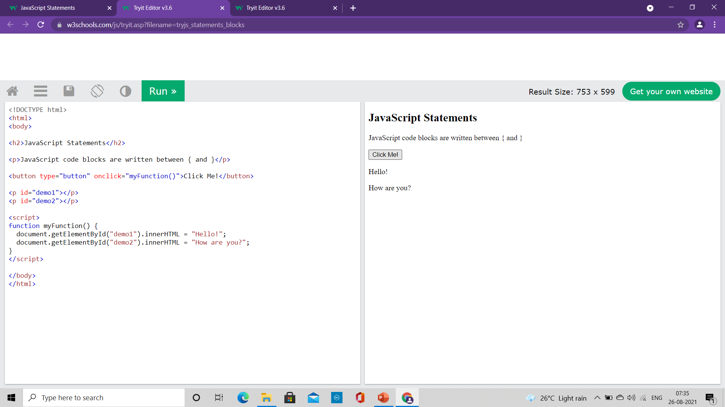
JavaScript Statements
JavaScript Code Blocks
JavaScript statements can be grouped together in code blocks, inside curly brackets {...}.
The purpose of code blocks is to define statements to be executed together.
One place you will find statements grouped together in blocks, is in JavaScript functions
<!DOCTYPE html>
<html>
<body>
<h2>JavaScript Statements</h2>
<p>JavaScript code blocks are written between { and }</p>
<button type="button" onclick="myFunction()">Click Me!</button>
<p id="demo1"></p>
<p id="demo2"></p>
<script>
function myFunction() {
document.getElementById("demo1").innerHTML = "Hello!";
document.getElementById("demo2").innerHTML = "How are you?";
}
</script>
</body>
</html>

Slide 29
JavaScript Keywords
JavaScript statements often start with a keyword to identify the JavaScript action to be performed.
Some of the keywords:
Keyword Description
var Declares a variable
let Declares a block variable
const Declares a block constant
if Marks a block of statements to be executed on a condition
switch Marks a block of statements to be executed in different cases
for Marks a block of statements to be executed in a loop
function Declares a function
return Exits a function
try Implements error handling to a block of statements

Slide 30
JavaScript Syntax
JavaScript syntax is the set of rules, how JavaScript programs are constructed
JavaScript Values
The JavaScript syntax defines two types of values:
Fixed values – Literals
Variable values – Variables
JavaScript Literals
The two most important syntax rules for fixed values are:
Numbers are written with or without decimals
Strings are text, written within double or single quotes
JavaScript Variables
In a programming language, variables are used to store data values.
JavaScript uses the keywords var, let and const to declare variables.
An equal sign is used to assign values to variables.

Slide 31
JavaScript Syntax
JavaScript syntax is the set of rules, how JavaScript programs are constructed
JavaScript Operators
Arithmetic operators: + , - , * , / , ** , % , ++ , --
Assignment operator: = , += , -= , *= , /= , %= , **=
String operator: + , +=
Comparison Operator: == (Equal to) , === (Equal Value and Equal Type), != , < , > , <= , >= , ?
Logical Operator: && , || , !
Type Operators: typeof, instanceof
Bitwise Operators: & , | , ~ , ^ , << , >>

Slide 32
JavaScript Syntax
JavaScript syntax is the set of rules, how JavaScript programs are constructed
JavaScript Operators
Arithmetic operators: Addition ( + ), Subtraction( - ), Multiplication( * ), Division ( / )
Assignment operator: ( = )
JavaScript Expressions
An expression is a combination of values, variables, and operators, which computes to a value.
The computation is called an evaluation.
For example, 5 * 10 evaluates to 50
Expressions can also contain variable values
The values can be of various types, such as numbers and strings.
For example, "John" + " " + "Doe", evaluates to "John Doe"

Slide 33
JavaScript Syntax
JavaScript Comments
Not all JavaScript statements are "executed".
Code after double slashes // or between /* and */ is treated as a comment.
Comments are ignored, and will not be executed
JavaScript Identifiers
Identifiers are names.
In JavaScript, identifiers are used to name variables (and keywords, and functions, and labels).
The rules for legal names are much the same in most programming languages.
In JavaScript, the first character must be a letter, or an underscore (_), or a dollar sign ($).
Numbers are not allowed as the first character.
Subsequent characters may be letters, digits, underscores, or dollar signs.
All JavaScript identifiers are case sensitive
JavaScript programmers tend to use camel case that starts with a lowercase letter:
Example: firstName, lastName, masterCard, interCity

Slide 34
JavaScript Functions
It is a block of code designed to perform a particular task
It is executed when "something" invokes it (calls it)
Syntax:
It is defined with the function keyword, followed by a name, followed by parentheses ().
Function names can contain letters, digits, underscores, and dollar signs (same rules as variables).
The parentheses may include parameter names separated by commas:
(parameter1, parameter2, ...)
The code to be executed, by the function, is placed inside curly brackets: { }
Function parameters are listed inside the parentheses () in the function definition.
Function arguments are the values received by the function when it is invoked.
Inside the function, the arguments (the parameters) behave as local variables.
A Function is much the same as a Procedure or a Subroutine, in other programming languages.
function name(parameter1, parameter2, parameter3) { // code to be executed }

Slide 35
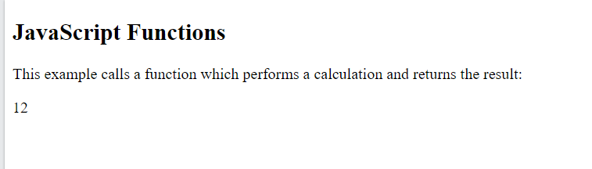
JavaScript Functions
Function Invocation
The code inside the function will execute when "something" invokes (calls) the function:
When an event occurs (when a user clicks a button)
When it is invoked (called) from JavaScript code
Automatically (self invoked)
Function Return
When JavaScript reaches a return statement, the function will stop executing.
If the function was invoked from a statement, JavaScript will "return" to execute the code after the invoking statement.
Functions often compute a return value. The return value is "returned" back to the "caller
<!DOCTYPE html>
<html>
<body>
<h2>JavaScript Functions</h2>
<p>This example calls a function which performs a calculation and returns the result:</p>
<p id="demo"></p>
<script>
var x = myFunction(4, 3);
document.getElementById("demo").innerHTML = x;
function myFunction(a, b) {
return a * b;
}
</script>
</body>
</html>

Slide 36
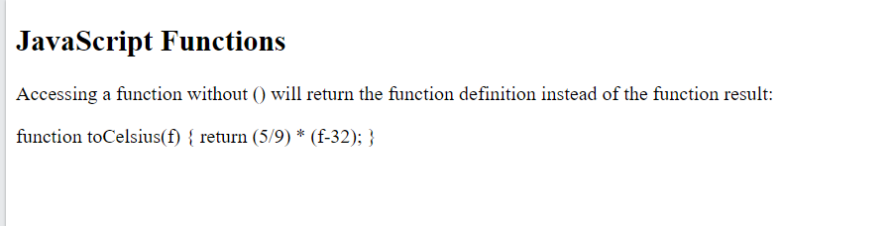
JavaScript Functions
Function Invocation
Accessing a function without () will return the function object instead of the function result.
<!DOCTYPE html>
<html>
<body>
<h2>JavaScript Functions</h2>
<p>Accessing a function without () will return the function definition instead of the function result:</p>
<p id="demo"></p>
<script>
function toCelsius(f) {
return (5/9) * (f-32);
}
document.getElementById("demo").innerHTML = toCelsius;
</script>
</body>
</html>

Slide 37
JavaScript Objects
Real Life Objects, Properties, and Methods
In real life, a car is an object.
A car has properties like weight and color, and methods like start and stop
All cars have the same properties, but the property values differ from car to car.
All cars have the same methods, but the methods are performed at different times.
JavaScript Objects
Objects are variables but it contain many values.
The values are written as name:value pairs (name and value separated by a colon).
It is a common practice to declare objects with the const keyword.
We can define (and create) a JavaScript object with an object literal
Spaces and line breaks are not important. An object definition can span multiple lines

Slide 38
JavaScript Objects
Function Invocation
Accessing a function without () will return the function object instead of the function result.
<!DOCTYPE html>
<html>
<body>
<h2>JavaScript Objects</h2>
<p id="demo"></p>
<script>
// Create an object:
const car = {type:"Fiat", model:"500", color:"white"};
// Display some data from the object:
document.getElementById("demo").innerHTML = "The car type is " + car.type;
</script>
</body>
</html>

Slide 40
What JavaScript can do?
Change HTML Style (CSS)
<!DOCTYPE html>
<html>
<body>
<h2>What Can JavaScript Do?</h2>
<p id="demo">JavaScript can change HTML content.</p>
<button type="button" onclick="document.getElementById('demo').innerHTML = 'Hello JavaScript!'">Click Me!</button>
</body>
</html>

Slide 41
What JavaScript can do?
Change HTML Attribute Values
<!DOCTYPE html>
<html>
<body>
<h2>What Can JavaScript Do?</h2>
<p>JavaScript can change HTML attribute values.</p>
<p>In this case JavaScript changes the value of the src (source) attribute of an image.</p>
<button onclick="document.getElementById('myImage').src='pic_bulbon.gif'">Turn on the light</button>
<img id="myImage" src="pic_bulboff.gif" style="width:100px">
<button onclick="document.getElementById('myImage').src='pic_bulboff.gif'">Turn off the light</button>
</body>
</html>

Slide 42
What JavaScript can do?
Change HTML Style (CSS)
<!DOCTYPE html>
<html>
<body>
<h2>What Can JavaScript Do?</h2>
<p id="demo">JavaScript can change the style of an HTML element.</p>
<button type="button" onclick="document.getElementById('demo').style.fontSize='35px'">Click Me!</button>
</body>
</html>

Slide 43
What JavaScript can do?
Hide HTML Elements
<!DOCTYPE html>
<html>
<body>
<h2>What Can JavaScript Do?</h2>
<p id="demo">JavaScript can hide HTML elements.</p>
<button type="button" onclick="document.getElementById('demo').style.display='none'">Click Me!</button>
</body>
</html>

Slide 44
What JavaScript can do?
Show HTML Elements
<!DOCTYPE html>
<html>
<body>
<h2>What Can JavaScript Do?</h2>
<p>JavaScript can show hidden HTML elements.</p>
<p id="demo" style="display:none">Hello JavaScript!</p>
<button type="button" onclick="document.getElementById('demo').style.display='block'">Click Me!</button>
</body>
</html>

Slide 45
Where to write JavaScript code?
The <script> Tag
In HTML, JavaScript code is inserted between <script> and </script> tags.
We can place any number of scripts in an HTML document.
Scripts can be placed in the <body>, or in the <head> section of an HTML page, or in both.
<!DOCTYPE html>
<html>
<body>
<h2>JavaScript in Body</h2>
<p id="demo"></p>
<script>
document.getElementById("demo").innerHTML = "My First JavaScript";
</script>
</body>
</html>

Slide 46
Where to write JavaScript code?
<!DOCTYPE html>
<html>
<head>
<script>
function myFunction() {
document.getElementById("demo").innerHTML = "Paragraph changed.";
}
</script>
</head>
<body>
<h2>JavaScript in Head</h2>
<p id="demo">A Paragraph.</p>
<button type="button" onclick="myFunction()">Try it</button>
</body>
</html>
A JavaScript function
It is a block of JavaScript code, that can be executed when "called" for.
Example: a function can be called when an event occurs, like when the user clicks a button.
Script is written in the head

Slide 47
Where to write JavaScript code?
<!DOCTYPE html>
<html>
<body>
<h2>JavaScript in Body</h2>
<p id="demo">A Paragraph.</p>
<button type="button" onclick="myFunction()">Try it</button>
<script>
function myFunction() {
document.getElementById("demo").innerHTML = "Paragraph changed.";
}
</script>
</body>
</html>
A JavaScript function
It is a block of JavaScript code, that can be executed when "called" for.
Example: a function can be called when an event occurs, like when the user clicks a button.
Script is written in the body

Slide 48
Where to write JavaScript code?
External JavaScript
Scripts can also be placed in external files
External scripts are practical when the same code is used in many different web pages.
JavaScript files have the file extension .js.
To use an external script, put the name of the script file in the src (source) attribute of a <script> tag
You can place an external script reference in <head> or <body> as you like.
The script will behave as if it was located exactly where the <script> tag is located.
External scripts cannot contain <script> tags.
<!DOCTYPE html>
<html>
<body>
<h2>External JavaScript</h2>
<p id="demo">A Paragraph.</p>
<button type="button" onclick="myFunction()">Try it</button>
<p>This example links to "myScript.js".</p>
<p>(myFunction is stored in "myScript.js")</p>
<script src="myScript.js"></script>
</body>
</html>
function myFunction() { document.getElementById("demo").innerHTML = "Paragraph changed."; }
myScript.js

Slide 49
Where to write JavaScript code?
External JavaScript
Placing scripts in external files has some advantages:
It separates HTML and code
It makes HTML and JavaScript easier to read and maintain
Cached JavaScript files can speed up page loads
To add several script files to one page - use several script tags:
<script src="myScript1.js"></script> <script src="myScript2.js"></script>

Slide 50
Where to write JavaScript code?
External References
An external script can be referenced in 3 different ways:
With a full URL (a full web address)
Example: <script src="https://www.w3schools.com/js/myScript.js"></script>
With a file path (like /js/)
Example: <script src="/js/myScript.js"></script>
Without any path
Example: <script src="myScript.js"></script>

Slide 51
JavaScript Output
JavaScript can "display" data in different ways:
Writing into an HTML element, using innerHTML.
Writing into the HTML output using document.write().
Writing into an alert box, using window.alert().
Writing into the browser console, using console.log().

Slide 52
JavaScript Output
<!DOCTYPE html> <html> <body> <h1>My First Web Page</h1> <p>My First Paragraph</p> <p id="demo"></p> <script> document.getElementById("demo").innerHTML = 5 + 6; </script> </body> </html>
innerHTML
To access an HTML element, JavaScript can use the document.getElementById(id) method.
The id attribute defines the HTML element. The innerHTML property defines the HTML content:

Slide 53
JavaScript Output
<!DOCTYPE html> <html> <body> <h1>My First Web Page</h1> <p>My first paragraph.</p> <script> document.write(5 + 6); </script> </body> </html>
Document.write()
For testing purposes, it is convenient to use document.write()
Using document.write() after an HTML document is loaded, will delete all existing HTML

Slide 54
JavaScript Output
<!DOCTYPE html> <html> <body> <h1>My First Web Page</h1> <p>My first paragraph.</p> <button type="button" onclick="document.write(5 + 6)">Try it</button> </body> </html>
Document.write()
For testing purposes, it is convenient to use document.write()
Using document.write() after an HTML document is loaded, will delete all existing HTML

Slide 55
JavaScript Output
<!DOCTYPE html> <html> <body> <h1>My First Web Page</h1> <p>My first paragraph.</p> <script> window.alert(5 + 6); </script> </body> </html>
windows.alert()
We can use an alert box to display data
We can skip the window keyword.
In JavaScript, the window object is the global scope object,
It means that variables, properties, and methods by default belong to the window object.
This also means that specifying the window keyword is optional

Slide 56
JavaScript Output
<!DOCTYPE html>
<html>
<body>
<h2>Activate Debugging</h2>
<p>F12 on your keyboard will activate debugging.</p>
<p>Then select "Console" in the debugger menu.</p>
<p>Then click Run again.</p>
<script>
console.log(5 + 6);
</script>
</body>
</html>
Console.log()
For debugging purposes, we can call the console.log() method in the browser to display data

Slide 57
JavaScript Output
<!DOCTYPE html>
<html>
<body>
<h2>The window.print() Method</h2>
<p>Click the button to print the current page.</p>
<button onclick="window.print()">Print this page</button>
</body>
</html>
windows.print()
JavaScript does not have any print object or print methods.
You cannot access output devices from JavaScript.
The only exception is that you can call the window.print() method in the browser to print the content of the current window.

Slide 58
JavaScript Output
<!DOCTYPE html>
<html>
<body>
<h2>The window.print() Method</h2>
<p>Click the button to print the current page.</p>
<button onclick="window.print()">Print this page</button>
</body>
</html>
windows.print()
JavaScript does not have any print object or print methods.
You cannot access output devices from JavaScript.
The only exception is that you can call the window.print() method in the browser to print the content of the current window.

Slide 59
Java Script
Module 2

Slide 60
Content

Slide 61
JavaScript Statements
<!DOCTYPE html>
<html>
<body>
<h2>JavaScript Statements</h2>
<p>A <b>JavaScript program</b> is a list of <b>statements</b> to be executed by a computer.</p>
<p id="demo"></p>
<script>
let x, y, z; // Statement 1
x = 5; // Statement 2
y = 6; // Statement 3
z = x + y; // Statement 4
document.getElementById("demo").innerHTML = "The value of z is " + z + ".";
</script>
</body>
</html>
A computer program is a list of "instructions" to be "executed" by a computer.
In a programming language, these programming instructions are called statements.
A JavaScript program is a list of programming statements.
In HTML, JavaScript programs are executed by the web browser.
JavaScript statements are composed of:
Values
Operators
Expressions
Keywords
Comments.

Slide 62
JavaScript Statements
Most JavaScript programs contain many JavaScript statements.
The statements are executed, one by one, in the same order as they are written.
JavaScript programs (and JavaScript statements) are often called JavaScript code
Semicolons:
Semicolons separate JavaScript statements.
Add a semicolon at the end of each executable statement
When separated by semicolons, multiple statements on one line are allowed
Ending statements with semicolon is not required, but highly recommended
<!DOCTYPE html>
<html>
<body>
<h2>JavaScript Statements</h2>
<p>A <b>JavaScript program</b> is a list of <b>statements</b> to be executed by a computer.</p>
<p id="demo"></p>
<script>
let x, y, z; // Statement 1
x = 5; // Statement 2
y = 6; // Statement 3
z = x + y; // Statement 4
document.getElementById("demo").innerHTML = "The value of z is " + z + ".";
</script>
</body>
</html>

Slide 63
JavaScript Statements
JavaScript White Space
JavaScript ignores multiple spaces.
We can add white space to your script to make it more readable
A good practice is to put spaces around operators ( = + - * / )
JavaScript Line Length and Line Breaks
For best readability, programmers often like to avoid code lines longer than 80 characters.
If a JavaScript statement does not fit on one line, the best place to break it is after an operator:
<!DOCTYPE html>
<html>
<body>
<h2>JavaScript Statements</h2>
<p>A <b>JavaScript program</b> is a list of <b>statements</b> to be executed by a computer.</p>
<p id="demo"></p>
<script>
let x, y, z; // Statement 1
x = 5; // Statement 2
y = 6; // Statement 3
z = x + y; // Statement 4
document.getElementById("demo").innerHTML = "The value of z is " + z + ".";
</script>
</body>
</html>

Slide 64
JavaScript Statements
JavaScript Code Blocks
JavaScript statements can be grouped together in code blocks, inside curly brackets {...}.
The purpose of code blocks is to define statements to be executed together.
One place you will find statements grouped together in blocks, is in JavaScript functions
<!DOCTYPE html>
<html>
<body>
<h2>JavaScript Statements</h2>
<p>JavaScript code blocks are written between { and }</p>
<button type="button" onclick="myFunction()">Click Me!</button>
<p id="demo1"></p>
<p id="demo2"></p>
<script>
function myFunction() {
document.getElementById("demo1").innerHTML = "Hello!";
document.getElementById("demo2").innerHTML = "How are you?";
}
</script>
</body>
</html>

Slide 65
JavaScript Keywords
JavaScript statements often start with a keyword to identify the JavaScript action to be performed.
Some of the keywords:
Keyword Description
var Declares a variable
let Declares a block variable
const Declares a block constant
if Marks a block of statements to be executed on a condition
switch Marks a block of statements to be executed in different cases
for Marks a block of statements to be executed in a loop
function Declares a function
return Exits a function
try Implements error handling to a block of statements

Slide 66
JavaScript Syntax
JavaScript syntax is the set of rules, how JavaScript programs are constructed
JavaScript Values
The JavaScript syntax defines two types of values:
Fixed values – Literals
Variable values – Variables
JavaScript Literals
The two most important syntax rules for fixed values are:
Numbers are written with or without decimals
Strings are text, written within double or single quotes
JavaScript Variables
In a programming language, variables are used to store data values.
JavaScript uses the keywords var, let and const to declare variables.
An equal sign is used to assign values to variables.

Slide 67
JavaScript Syntax
JavaScript syntax is the set of rules, how JavaScript programs are constructed
JavaScript Operators
Arithmetic operators: + , - , * , / , ** , % , ++ , --
Assignment operator: = , += , -= , *= , /= , %= , **=
String operator: + , +=
Comparison Operator: == (Equal to) , === (Equal Value and Equal Type), != , < , > , <= , >= , ?
Logical Operator: && , || , !
Type Operators: typeof, instanceof
Bitwise Operators: & , | , ~ , ^ , << , >>

Slide 68
JavaScript Syntax
JavaScript syntax is the set of rules, how JavaScript programs are constructed
JavaScript Operators
Arithmetic operators: Addition ( + ), Subtraction( - ), Multiplication( * ), Division ( / )
Assignment operator: ( = )
JavaScript Expressions
An expression is a combination of values, variables, and operators, which computes to a value.
The computation is called an evaluation.
For example, 5 * 10 evaluates to 50
Expressions can also contain variable values
The values can be of various types, such as numbers and strings.
For example, "John" + " " + "Doe", evaluates to "John Doe"

Slide 69
JavaScript Syntax
JavaScript Comments
Not all JavaScript statements are "executed".
Code after double slashes // or between /* and */ is treated as a comment.
Comments are ignored, and will not be executed
JavaScript Identifiers
Identifiers are names.
In JavaScript, identifiers are used to name variables (and keywords, and functions, and labels).
The rules for legal names are much the same in most programming languages.
In JavaScript, the first character must be a letter, or an underscore (_), or a dollar sign ($).
Numbers are not allowed as the first character.
Subsequent characters may be letters, digits, underscores, or dollar signs.
All JavaScript identifiers are case sensitive
JavaScript programmers tend to use camel case that starts with a lowercase letter:
Example: firstName, lastName, masterCard, interCity

Slide 70
JavaScript Functions
It is a block of code designed to perform a particular task
It is executed when "something" invokes it (calls it)
Syntax:
It is defined with the function keyword, followed by a name, followed by parentheses ().
Function names can contain letters, digits, underscores, and dollar signs (same rules as variables).
The parentheses may include parameter names separated by commas:
(parameter1, parameter2, ...)
The code to be executed, by the function, is placed inside curly brackets: { }
Function parameters are listed inside the parentheses () in the function definition.
Function arguments are the values received by the function when it is invoked.
Inside the function, the arguments (the parameters) behave as local variables.
A Function is much the same as a Procedure or a Subroutine, in other programming languages.
function name(parameter1, parameter2, parameter3) { // code to be executed }

Slide 71
JavaScript Functions
Function Invocation
The code inside the function will execute when "something" invokes (calls) the function:
When an event occurs (when a user clicks a button)
When it is invoked (called) from JavaScript code
Automatically (self invoked)
Function Return
When JavaScript reaches a return statement, the function will stop executing.
If the function was invoked from a statement, JavaScript will "return" to execute the code after the invoking statement.
Functions often compute a return value. The return value is "returned" back to the "caller
<!DOCTYPE html>
<html>
<body>
<h2>JavaScript Functions</h2>
<p>This example calls a function which performs a calculation and returns the result:</p>
<p id="demo"></p>
<script>
var x = myFunction(4, 3);
document.getElementById("demo").innerHTML = x;
function myFunction(a, b) {
return a * b;
}
</script>
</body>
</html>

Slide 72
JavaScript Functions
Function Invocation
Accessing a function without () will return the function object instead of the function result.
<!DOCTYPE html>
<html>
<body>
<h2>JavaScript Functions</h2>
<p>Accessing a function without () will return the function definition instead of the function result:</p>
<p id="demo"></p>
<script>
function toCelsius(f) {
return (5/9) * (f-32);
}
document.getElementById("demo").innerHTML = toCelsius;
</script>
</body>
</html>

Slide 73
JavaScript Objects

Slide 74
JavaScript Objects
Real Life Objects, Properties, and Methods
In real life, a car is an object.
A car has properties like weight and color, and methods like start and stop
All cars have the same properties, but the property values differ from car to car.
All cars have the same methods, but the methods are performed at different times.
JavaScript Objects
Objects are variables but it contain many values.
The values are written as name:value pairs (name and value separated by a colon).
It is a common practice to declare objects with the const keyword.
We can define (and create) a JavaScript object with an object literal
Spaces and line breaks are not important.
An object definition can span multiple lines

Slide 75
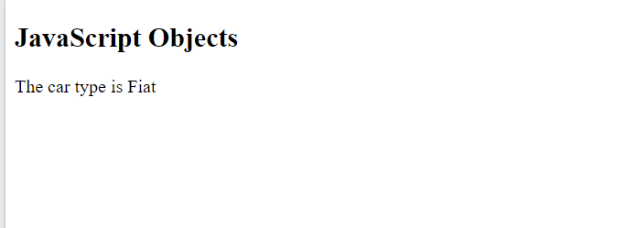
JavaScript Objects
<!DOCTYPE html>
<html>
<body>
<h2>JavaScript Objects</h2>
<p id="demo"></p>
<script>
// Create an object:
const car = {type:"Fiat", model:"500", color:"white"};
// Display some data from the object:
document.getElementById("demo").innerHTML = "The car type is " + car.type;
</script>
</body>
</html>
Object Definition on Single Line

Slide 76
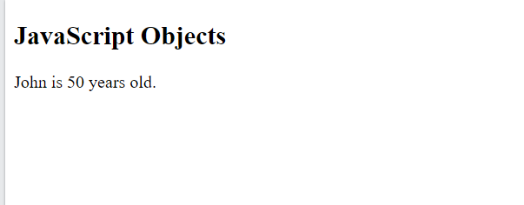
JavaScript Objects
<!DOCTYPE html>
<html>
<body>
<h2>JavaScript Objects</h2>
<p id="demo"></p>
<script>
// Create an object:
const person = {
firstName: "John",
lastName: "Doe",
age: 50,
eyeColor: "blue"
};
// Display some data from the object:
document.getElementById("demo").innerHTML =
person.firstName + " is " + person.age + " years old.";
</script>
</body>
</html>
Object Definition on Multiple Line

Slide 77
JavaScript Objects
Object Properties
The name:values pairs in JavaScript objects are called properties:
Property Property Value
firstName John
lastName Doe
age 50
eyeColor blue
You can access object properties in two ways:
objectName.propertyName
or
objectName["propertyName"]

Slide 78
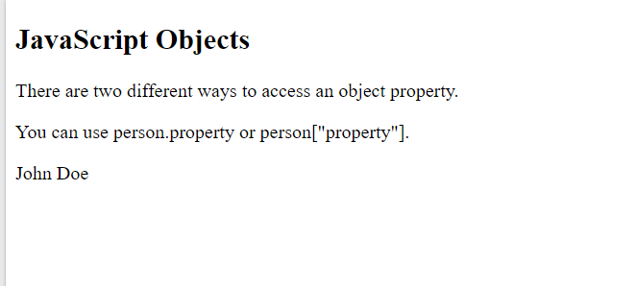
JavaScript Objects
<!DOCTYPE html>
<html>
<body>
<h2>JavaScript Objects</h2>
<p>There are two different ways to access an object property.</p>
<p>You can use person.property or person["property"].</p>
<p id="demo"></p>
<script>
// Create an object:
const person = {
firstName: "John",
lastName : "Doe",
id : 5566
};
// Display some data from the object:
document.getElementById("demo").innerHTML =
person["firstName"] + " " + person["lastName"];
</script>
</body>
</html>
Accessing Property Value

Slide 79
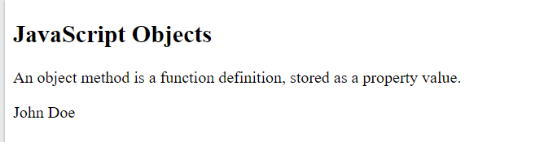
JavaScript Objects
<!DOCTYPE html>
<html>
<body>
<h2>JavaScript Objects</h2>
<p>An object method is a function definition, stored as a property value.</p>
<p id="demo"></p>
<script>
// Create an object:
const person = {
firstName: "John",
lastName: "Doe",
id: 5566,
fullName: function() {
return this.firstName + " " + this.lastName;
}
};
// Display data from the object:
document.getElementById("demo").innerHTML = person.fullName();
</script>
</body>
</html>
Object Methods
Objects can also have methods.
Methods are actions that can be performed on objects.
Methods are stored in properties as function definitions.
A method is a function stored as a property.
Property Property Value
firstName John
lastName Doe
age 50
eyeColor blue
fullName function() {return this.firstName + " " + this.lastName;}

Slide 80
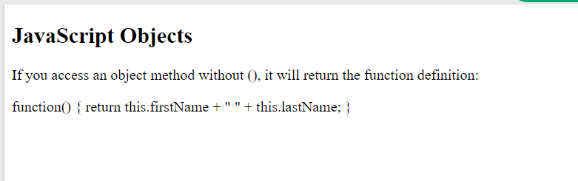
JavaScript Objects
<!DOCTYPE html>
<html>
<body>
<h2>JavaScript Objects</h2>
<p>An object method is a function definition, stored as a property value.</p>
<p id="demo"></p>
<script>
// Create an object:
const person = {
firstName: "John",
lastName: "Doe",
id: 5566,
fullName: function() {
return this.firstName + " " + this.lastName;
}
};
// Display data from the object:
document.getElementById("demo").innerHTML = person.fullName;
</script>
</body>
</html>
Accessing Object Methods
We can access an object method with the following syntax:
objectName.methodName()
If you access a method without the () parentheses, it will return the function definition

Slide 81
JavaScript Date

Slide 82
JavaScript Date
JavaScript Date Object lets us work with dates
JavaScript will use the browser's time zone and display a date as a full text string
Fri Aug 27 2021 12:12:10 GMT+0530 (India Standard Time)
Date objects are created with the new Date() constructor.
There are 4 ways to create a new date object:
new Date()
new Date(year, month, day, hours, minutes, seconds, milliseconds)
new Date(milliseconds)
new Date(date string)

Slide 83
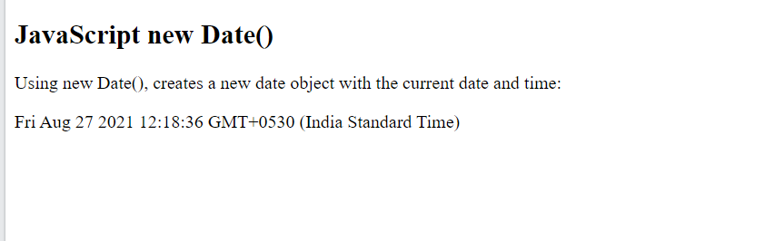
JavaScript Date
<!DOCTYPE html>
<html>
<body>
<h2>JavaScript new Date()</h2>
<p>Using new Date(), creates a new date object with the current date and time:</p>
<p id="demo"></p>
<script>
const d = new Date();
document.getElementById("demo").innerHTML = d;
</script>
</body>
</html>
new Date( )
It creates a new date object with the current date and time
Date objects are static.
The computer time is ticking, but date objects are not
Example
const d = new Date( );

Slide 84
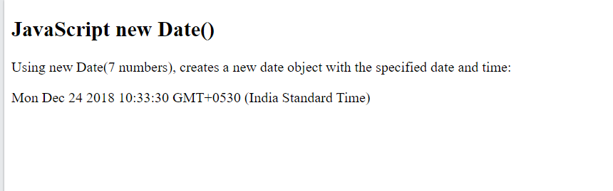
JavaScript Date
new Date(year, month, ...)
It creates a new date object with a specified date and time.
7 numbers specify year, month, day, hour, minute, second, and millisecond (in that order)
Example
const d = new Date(2018, 11, 24, 10, 33, 30, 0);
JavaScript counts months from 0 to 11:
January = 0.
December = 11.
Specifying a month higher than 11, will not result in an error but add the overflow to the next year
Specifying: const d = new Date(2018, 15, 24, 10, 33, 30);
Is the same as: const d = new Date(2019, 3, 24, 10, 33, 30);
Specifying a day higher than max, will not result in an error but add the overflow to the next month:
<!DOCTYPE html>
<html>
<body>
<h2>JavaScript new Date()</h2>
<p>Using new Date(), creates a new date object with the current date and time:</p>
<p id="demo"></p>
<script>
const d = new Date(2018, 11, 24, 10, 33, 30, 0);
document.getElementById("demo").innerHTML = d;
</script>
</body>
</html>

Slide 85

JavaScript Date
new Date(dateString)
It creates a new date object from a date string
Example
const d = new Date("October 13, 2014 11:13:00");
<!DOCTYPE html>
<html>
<body>
<h2>JavaScript new Date()</h2>
<p>A Date object can be created with a specified date and time:</p>
<p id="demo"></p>
<script>
const d = new Date("October 13, 2014 11:13:00");
document.getElementById("demo").innerHTML = d;
</script>
</body>
</html>

Slide 86
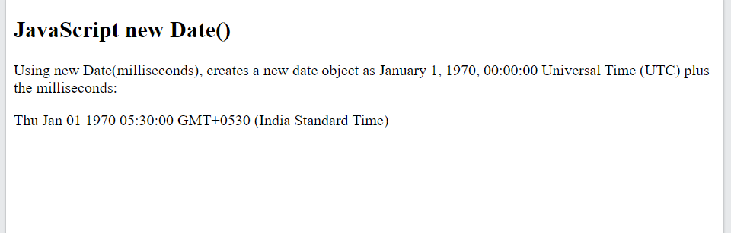
JavaScript Date
new Date(milliseconds)
It creates a new date object as zero time plus milliseconds
Example
const d = new Date(0);
JavaScript stores dates as number of milliseconds since January 01, 1970, 00:00:00 UTC (Universal Time Coordinated).
Zero time is January 01, 1970 00:00:00 UTC.
One day (24 hours) is 86 400 000 milliseconds
<!DOCTYPE html>
<html>
<body>
<h2>JavaScript new Date()</h2>
<p>A Date object can be created with a specified date and time:</p>
<p id="demo"></p>
<script>
const d = new Date(0);
document.getElementById("demo").innerHTML = d;
</script>
</body>
</html>

Slide 87
JavaScript Date
Date Methods
When a Date object is created, a number of methods allow you to operate on it.
Date methods allow you to get and set the year, month, day, hour, minute, second, and millisecond of date objects, using either local time or UTC (universal, or GMT) time.
JavaScript will (by default) output dates in full text string format:
Fri Aug 27 2021 12:12:10 GMT+0530 (India Standard Time)
d.toString( ) method: Convert date object into string
d.toUTCString( ) method: converts a date to a UTC string (a date display standard)
Format: Fri, 27 Aug 2021 07:16:54 GMT
d.toDateString( ) method: converts a date to a more readable format
Format: Fri Aug 27 2021
How to use it?
const d = new Date();
document.getElementById("demo").innerHTML = d.toDateString();

Slide 88
JavaScript Date
Date Formats
There are generally 3 types of JavaScript date input formats:
Type Example
ISO Date "2015-03-25" (The International Standard)
Short Date "03/25/2015"
Long Date "Mar 25 2015" or "25 Mar 2015“
The ISO format follows a strict standard in JavaScript.
The other formats are not so well defined and might be browser specific

Slide 89
JavaScript Date
JavaScript ISO Dates
ISO 8601 is the international standard for the representation of dates and times.
The ISO 8601 syntax (YYYY-MM-DD) is also the preferred JavaScript date format
The computed date will be relative to your time zone.
Example (Complete date) const d = new Date("2015-03-25");
ISO dates can be written without specifying the day (YYYY-MM):
Example const d = new Date("2015-03");
ISO dates can be written without month and day (YYYY):
Example: const d = new Date("2015");
ISO dates can be written with added hours, minutes, and seconds (YYYY-MM-DDTHH:MM:SSZ):
Example const d = new Date("2015-03-25T12:00:00Z");
Date and time is separated with a capital T.
UTC time is defined with a capital letter Z.
If you want to modify the time relative to UTC, remove the Z and add +HH:MM or -HH:MM instead:
Example: const d = new Date("2015-03-25T12:00:00-06:30");

Slide 90
JavaScript Date
JavaScript Short Dates
Short dates are written with an "MM/DD/YYYY" syntax like
Example
const d = new Date("03/25/2015");
In some browsers, months or days with no leading zeroes may produce an error:
Example: const d = new Date("2015-3-25");
The behavior of "YYYY/MM/DD" is undefined.
Some browsers will try to guess the format. Some will return NaN.
Example: const d = new Date("2015/03/25");
The behavior of "DD-MM-YYYY" is also undefined.
Some browsers will try to guess the format. Some will return NaN.
Example: const d = new Date("25-03-2015");

Slide 91
JavaScript Date
JavaScript Long Dates
Long dates are most often written with a "MMM DD YYYY" syntax like this:
Example
const d = new Date("Mar 25 2015");
Month and day can be in any order
Month can be written in full (January), or abbreviated (Jan)
Commas are ignored.
Names are case insensitive

Slide 92
JavaScript Date
JavaScript Get Date Methods
Method Description
getFullYear() Get the year as a four digit number (yyyy)
getMonth() Get the month as a number (0-11)
getDate() Get the day as a number (1-31)
getHours() Get the hour (0-23)
getMinutes() Get the minute (0-59)
getSeconds() Get the second (0-59)
getMilliseconds() Get the millisecond (0-999)
getTime() Get the time (milliseconds since January 1, 1970)
getDay() Get the weekday as a number (0-6)
Date.now() Get the time.

Slide 93
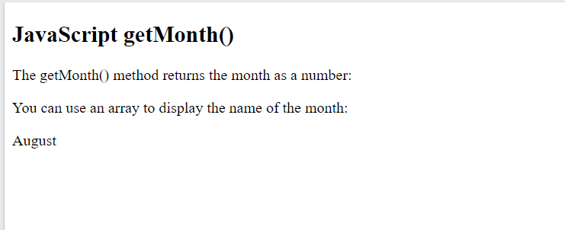
JavaScript Date
<!DOCTYPE html>
<html>
<body>
<h2>JavaScript getMonth()</h2>
<p>The getMonth() method returns the month as a number:</p>
<p>You can use an array to display the name of the month:</p>
<p id="demo"></p>
<script>
const d = new Date();
const months = ["January","February","March","April","May","June","July","August","September","October","November","December"];
document.getElementById("demo").innerHTML = months[d.getMonth()];
</script>
</body>
</html>

Slide 94
JavaScript Date
JavaScript Set Date Methods
Method Description
setDate() Set the day as a number (1-31)
setFullYear() Set the year (optionally month and day)
setHours() Set the hour (0-23)
setMilliseconds() Set the milliseconds (0-999)
setMinutes() Set the minutes (0-59)
setMonth() Set the month (0-11)
setSeconds() Set the seconds (0-59)
setTime() Set the time (milliseconds since January 1, 1970)

Slide 95
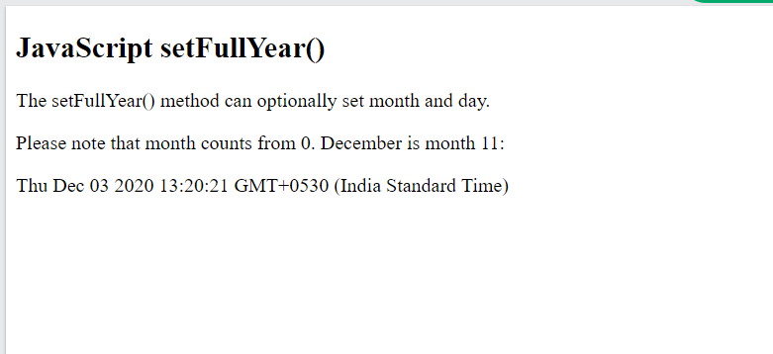
JavaScript Date
<!DOCTYPE html>
<html>
<body>
<h2>JavaScript setFullYear()</h2>
<p>The setFullYear() method can optionally set month and day.</p>
<p>Please note that month counts from 0. December is month 11:</p>
<p id="demo"></p>
<script>
const d = new Date();
d.setFullYear(2020, 11, 3);
document.getElementById("demo").innerHTML = d;
</script>
</body>
</html>

Slide 96
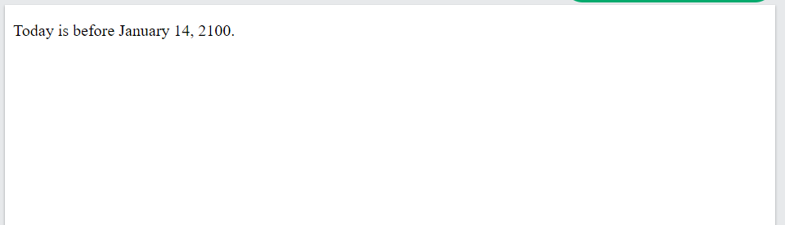
JavaScript Date
<!DOCTYPE html>
<html>
<body>
<p id="demo"></p>
<script>
let text;
const today = new Date();
const someday = new Date();
someday.setFullYear(2100, 0, 14);
if (someday > today) {
text = "Today is before January 14, 2100.";
} else {
text = "Today is after January 14, 2100.";
}
document.getElementById("demo").innerHTML = text;
</script>
</body>
</html>
Comparing Dates
Dates can be easily compared

Slide 97
JavaScript Regular Expression

Slide 98
JavaScript Regular Expression
A regular expression is a sequence of characters that forms a search pattern.
When you search for data in a text, you can use this search pattern to describe what you are searching for.
A regular expression can be a single character, or a more complicated pattern.
Regular expressions can be used to perform all types of text search and text replace operations.
Syntax
/pattern/modifiers;
Example
/w3schools/i;
/w3schools/i is a regular expression.
w3schools is a pattern (to be used in a search).
i is a modifier (modifies the search to be case-insensitive).

Slide 99
JavaScript Regular Expression
Using String Methods
In JavaScript, regular expressions are often used with the two string methods: search() and replace().
The search() method: It uses an expression to search for a match, and returns the position of the match.
The replace() method: It returns a modified string where the pattern is replaced.

Slide 100
JavaScript Regular Expression
String search() With a String
The search() method searches a string for a specified value and returns the position of the match:
Example: Use a string to do a search for "W3schools" in a string:
let text = "Visit W3Schools!";
let n = text.search("W3Schools");
The result in n will be: 6
String search() With a Regular Expression
Example: Use a regular expression to do a case-insensitive search for "w3schools" in a string
let text = "Visit W3Schools";
let n = text.search(/w3schools/i);
The result in n will be: 6

Slide 101
JavaScript Regular Expression
String replace() With a String
The replace() method replaces a specified value with another value in a string
Example:
let text = "Visit Microsoft!";
let result = text.replace("Microsoft", "W3Schools");
The result in result will be: visit W3Schools
String replace() With a Regular Expression
Example: Use a regular expression to do a case-insensitive search for "w3schools" in a string
let text = "Visit Microsoft!";
let res = text.replace(/microsoft/i, "W3Schools");
The result in res will be: W3Schools

Slide 102
JavaScript Regular Expression
Regular expression arguments (instead of string arguments) can be used in the methods
Regular expressions can make your search much more powerful (case insensitive for example)
Regular Expression Modifiers
Modifiers can be used to perform case-insensitive more global searches:
Modifier Description
i Perform case-insensitive matching
g Perform a global match (find all matches rather than stopping after the first match)
m Perform multiline matching

Slide 103
JavaScript Regular Expression
Regular Expression Patterns
Brackets are used to find a range of characters:
Expression Description
[abc] Find any of the characters between the brackets
[0-9] Find any of the digits between the brackets
(x|y) Find any of the alternatives separated with |
Metacharacters are characters with a spec
Metacharacter Description
\d Find a digit
\s Find a whitespace character
\b Find a match at the beginning of a word like this: \bWORD, or at the end of a word like this: WORD\
\uxxxx Find the Unicode character specified by the hexadecimal number xxxx

Slide 104
JavaScript Regular Expression
Regular Expression Patterns
Quantifiers Description
n+ Matches any string that contains at least one n
n* Matches any string that contains zero or more occurrences of n
n? Matches any string that contains zero or one occurrences of n

Slide 105
JavaScript Regular Expression
Using the RegExp Object
In JavaScript, the RegExp object is a regular expression object with predefined properties and methods.
Using test()
The test() method is a RegExp expression method.
It searches a string for a pattern, and returns true or false, depending on the result.
The following example searches a string for the character "e":
Example
const pattern = /e/;
pattern.test("The best things in life are free!");
Since there is an "e“ in the string, the output of the code above will be: true
You don't have to put the regular expression in a variable first. The two lines above can be shortened to one:
/e/.test("The best things in life are free!");

Slide 106
JavaScript Regular Expression
Using the RegExp Object
In JavaScript, the RegExp object is a regular expression object with predefined properties and methods.
Using exec()
The exec() method is a RegExp expression method.
It searches a string for a specified pattern, and returns the found text as an object.
If no match is found, it returns an empty (null) object.
The following example searches a string for the character "e":
Example
/e/.exec("The best things in life are free!");

Slide 108
Where to write JavaScript code?
<!DOCTYPE html>
<html>
<head>
<script>
function myFunction() {
document.getElementById("demo").innerHTML = "Paragraph changed.";
}
</script>
</head>
<body>
<h2>JavaScript in Head</h2>
<p id="demo">A Paragraph.</p>
<button type="button" onclick="myFunction()">Try it</button>
</body>
</html>
A JavaScript function
It is a block of JavaScript code, that can be executed when "called" for.
Example: a function can be called when an event occurs, like when the user clicks a button.
Script is written in the head

Slide 109
Where to write JavaScript code?
<!DOCTYPE html>
<html>
<body>
<h2>JavaScript in Body</h2>
<p id="demo">A Paragraph.</p>
<button type="button" onclick="myFunction()">Try it</button>
<script>
function myFunction() {
document.getElementById("demo").innerHTML = "Paragraph changed.";
}
</script>
</body>
</html>
A JavaScript function
It is a block of JavaScript code, that can be executed when "called" for.
Example: a function can be called when an event occurs, like when the user clicks a button.
Script is written in the body

Slide 110
Where to write JavaScript code?
External JavaScript
Scripts can also be placed in external files
External scripts are practical when the same code is used in many different web pages.
JavaScript files have the file extension .js.
To use an external script, put the name of the script file in the src (source) attribute of a <script> tag
You can place an external script reference in <head> or <body> as you like.
The script will behave as if it was located exactly where the <script> tag is located.
External scripts cannot contain <script> tags.
<!DOCTYPE html>
<html>
<body>
<h2>External JavaScript</h2>
<p id="demo">A Paragraph.</p>
<button type="button" onclick="myFunction()">Try it</button>
<p>This example links to "myScript.js".</p>
<p>(myFunction is stored in "myScript.js")</p>
<script src="myScript.js"></script>
</body>
</html>
function myFunction() { document.getElementById("demo").innerHTML = "Paragraph changed."; }
myScript.js

Slide 111
Where to write JavaScript code?
External JavaScript
Placing scripts in external files has some advantages:
It separates HTML and code
It makes HTML and JavaScript easier to read and maintain
Cached JavaScript files can speed up page loads
To add several script files to one page - use several script tags:
<script src="myScript1.js"></script> <script src="myScript2.js"></script>

Slide 112
Where to write JavaScript code?
External References
An external script can be referenced in 3 different ways:
With a full URL (a full web address)
Example: <script src="https://www.w3schools.com/js/myScript.js"></script>
With a file path (like /js/)
Example: <script src="/js/myScript.js"></script>
Without any path
Example: <script src="myScript.js"></script>

Slide 113
JavaScript Output
JavaScript can "display" data in different ways:
Writing into an HTML element, using innerHTML.
Writing into the HTML output using document.write().
Writing into an alert box, using window.alert().
Writing into the browser console, using console.log().

Slide 114
JavaScript Output
<!DOCTYPE html> <html> <body> <h1>My First Web Page</h1> <p>My First Paragraph</p> <p id="demo"></p> <script> document.getElementById("demo").innerHTML = 5 + 6; </script> </body> </html>
innerHTML
To access an HTML element, JavaScript can use the document.getElementById(id) method.
The id attribute defines the HTML element. The innerHTML property defines the HTML content:

Slide 115
JavaScript Output
<!DOCTYPE html> <html> <body> <h1>My First Web Page</h1> <p>My first paragraph.</p> <script> document.write(5 + 6); </script> </body> </html>
Document.write()
For testing purposes, it is convenient to use document.write()
Using document.write() after an HTML document is loaded, will delete all existing HTML

Slide 116
JavaScript Output
<!DOCTYPE html> <html> <body> <h1>My First Web Page</h1> <p>My first paragraph.</p> <button type="button" onclick="document.write(5 + 6)">Try it</button> </body> </html>
Document.write()
For testing purposes, it is convenient to use document.write()
Using document.write() after an HTML document is loaded, will delete all existing HTML

Slide 117
JavaScript Output
<!DOCTYPE html> <html> <body> <h1>My First Web Page</h1> <p>My first paragraph.</p> <script> window.alert(5 + 6); </script> </body> </html>
windows.alert()
We can use an alert box to display data
We can skip the window keyword.
In JavaScript, the window object is the global scope object,
It means that variables, properties, and methods by default belong to the window object.
This also means that specifying the window keyword is optional

Slide 118
JavaScript Output
<!DOCTYPE html>
<html>
<body>
<h2>Activate Debugging</h2>
<p>F12 on your keyboard will activate debugging.</p>
<p>Then select "Console" in the debugger menu.</p>
<p>Then click Run again.</p>
<script>
console.log(5 + 6);
</script>
</body>
</html>
Console.log()
For debugging purposes, we can call the console.log() method in the browser to display data

Slide 119
JavaScript Output
<!DOCTYPE html>
<html>
<body>
<h2>The window.print() Method</h2>
<p>Click the button to print the current page.</p>
<button onclick="window.print()">Print this page</button>
</body>
</html>
windows.print()
JavaScript does not have any print object or print methods.
You cannot access output devices from JavaScript.
The only exception is that you can call the window.print() method in the browser to print the content of the current window.

Slide 120
JavaScript Output
<!DOCTYPE html>
<html>
<body>
<h2>The window.print() Method</h2>
<p>Click the button to print the current page.</p>
<button onclick="window.print()">Print this page</button>
</body>
</html>
windows.print()
JavaScript does not have any print object or print methods.
You cannot access output devices from JavaScript.
The only exception is that you can call the window.print() method in the browser to print the content of the current window.

Slide 121
Java Script
Module 2

Slide 122
Content
JavaScript Errors
JavaScript Exception Handling
Document Object Model

Slide 123
JavaScript Errors
The try statement lets you test a block of code for errors.
The catch statement lets you handle the error.
The throw statement lets you create custom errors.
The finally statement lets you execute code, after try and catch, regardless of the result.

Slide 124
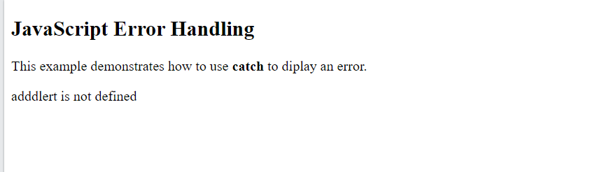
JavaScript Errors
<!DOCTYPE html>
<html>
<body>
<h2>JavaScript Error Handling</h2>
<p>This example demonstrates how to use <b>catch</b> to diplay an error.</p>
<p id="demo"></p>
<script>
try {
adddlert("Welcome guest!");
}
catch(err) {
document.getElementById("demo").innerHTML = err.message;
}
</script>
</body>
</html>
When executing JavaScript code, different errors can occur.
Errors can be coding errors made by the programmer, errors due to wrong input, and other unforeseeable things.
Example
In this example we misspelled "alert" as "adddlert" to deliberately produce an error
JavaScript catches adddlert as an error, and executes the catch code to handle it.

Slide 125
JavaScript try and catch
<!DOCTYPE html>
<html>
<body>
<h2>JavaScript Error Handling</h2>
<p>This example demonstrates how to use <b>catch</b> to diplay an error.</p>
<p id="demo"></p>
<script>
try {
adddlert("Welcome guest!");
}
catch(err) {
document.getElementById("demo").innerHTML = err.message;
}
</script>
</body>
</html>
The try statement allows you to define a block of code to be tested for errors while it is being executed.
The catch statement allows you to define a block of code to be executed, if an error occurs in the try block.
The JavaScript statements try and catch come in pairs
try {
Block of code to try
}
catch(err) {
Block of code to handle errors
}

Slide 126
JavaScript Throws Errors
When an error occurs, JavaScript will normally stop and generate an error message.
The technical term for this is: JavaScript will throw an exception (throw an error).
JavaScript will actually create an Error object with two properties:
name
message.
The throw Statement
The throw statement allows you to create a custom error.
Technically you can throw an exception (throw an error).
The exception can be a JavaScript String, a Number, a Boolean or an Object:
throw "Too big"; // throw a text
throw 500; // throw a number
If you use throw together with try and catch, you can control program flow and generate custom error messages.

Slide 127
The throw Statement
The throw statement allows you to create a custom error.
Technically you can throw an exception (throw an error).
The exception can be a JavaScript String, a Number, a Boolean or an Object:
throw "Too big"; // throw a text
throw 500; // throw a number
If you use throw together with try and catch, you can control program flow and generate custom error messages.

Slide 128
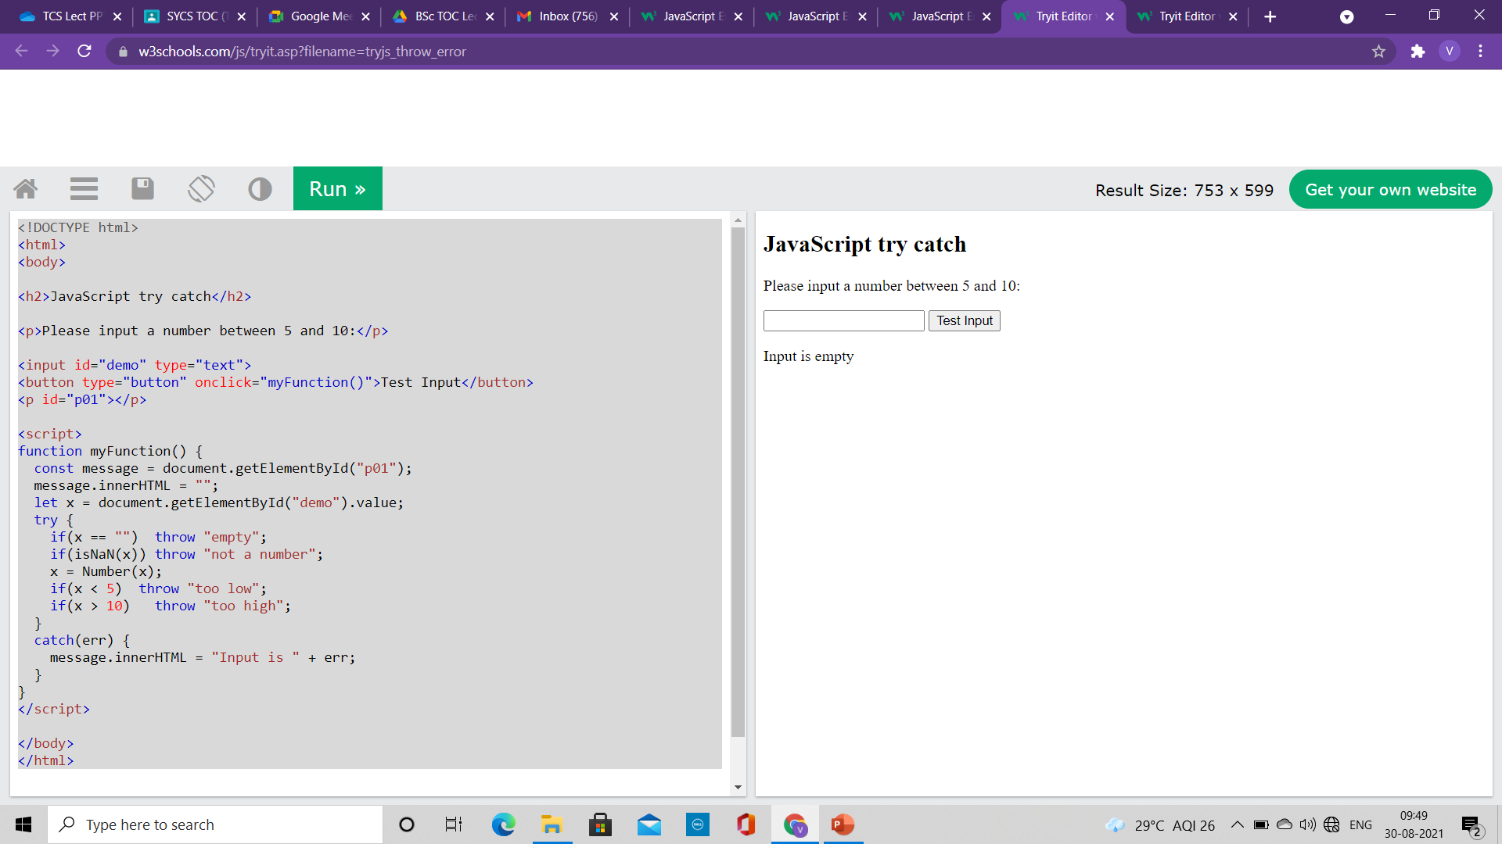
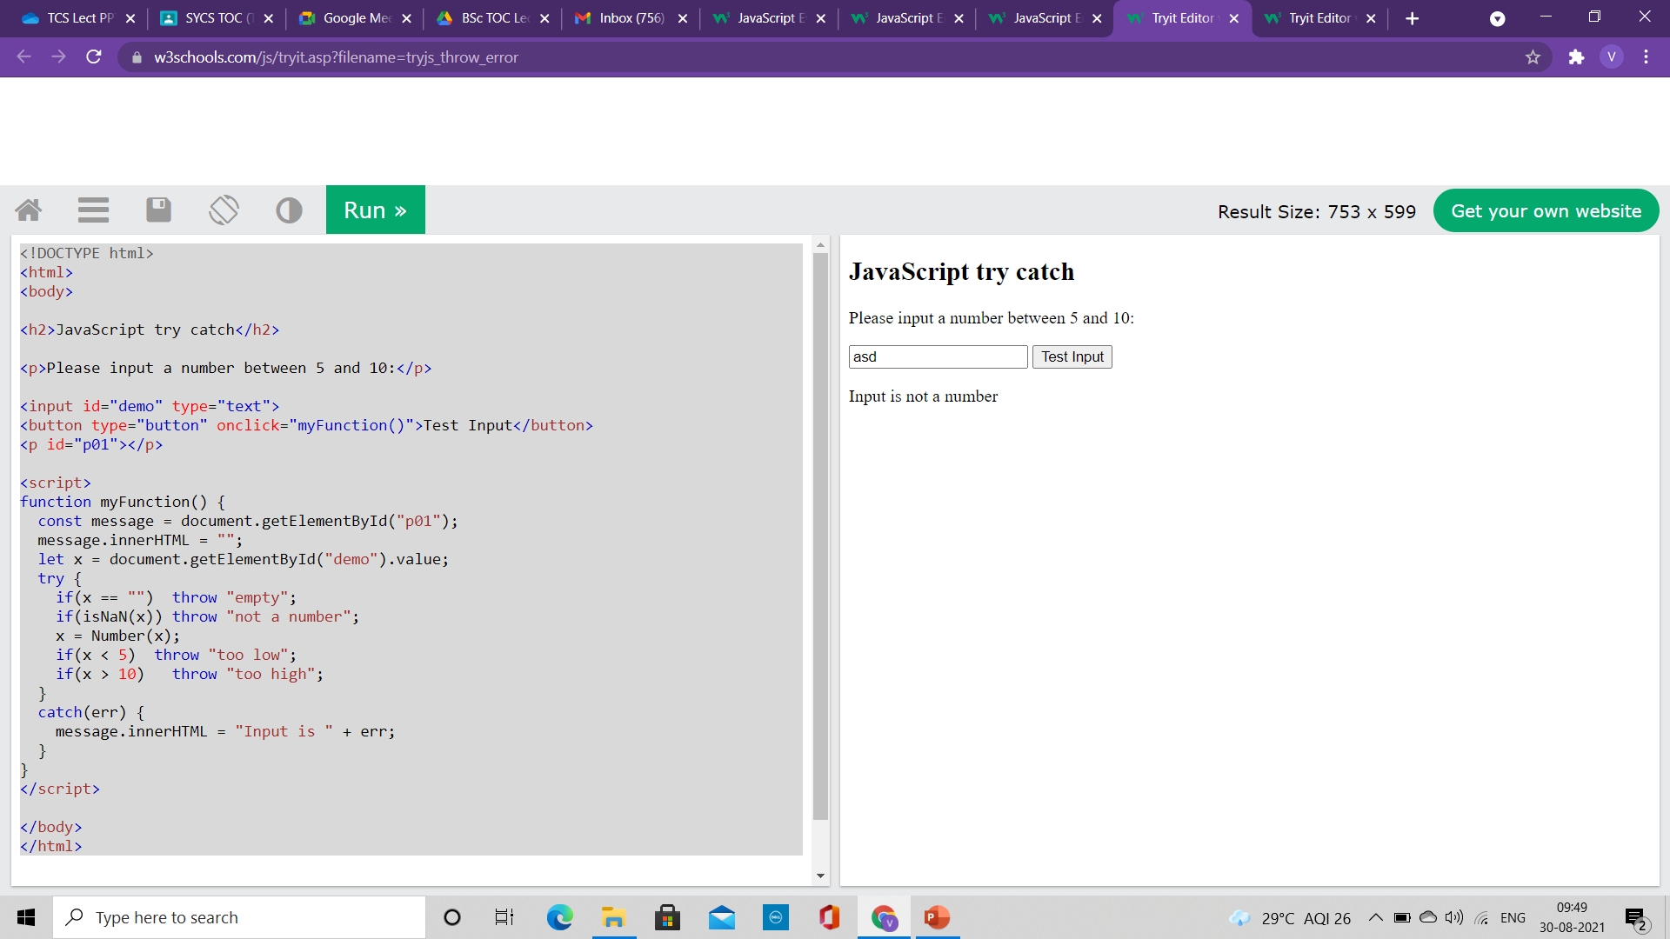
Input Validation
This example examines input. If the value is wrong, an exception (err) is thrown.
The exception (err) is caught by the catch statement and a custom error message is displayed:
<!DOCTYPE html>
<html>
<body>
<h2>JavaScript try catch</h2>
<p>Please input a number between 5 and 10:</p>
<input id="demo" type="text">
<button type="button" onclick="myFunction()">Test Input</button>
<p id="p01"></p>
<script>
function myFunction() {
const message = document.getElementById("p01");
message.innerHTML = "";
let x = document.getElementById("demo").value;
try {
if(x == "") throw "empty";
if(isNaN(x)) throw "not a number";
x = Number(x);
if(x < 5) throw "too low";
if(x > 10) throw "too high";
}
catch(err) {
message.innerHTML = "Input is " + err;
}
}
</script>
</body>
</html>

Slide 129
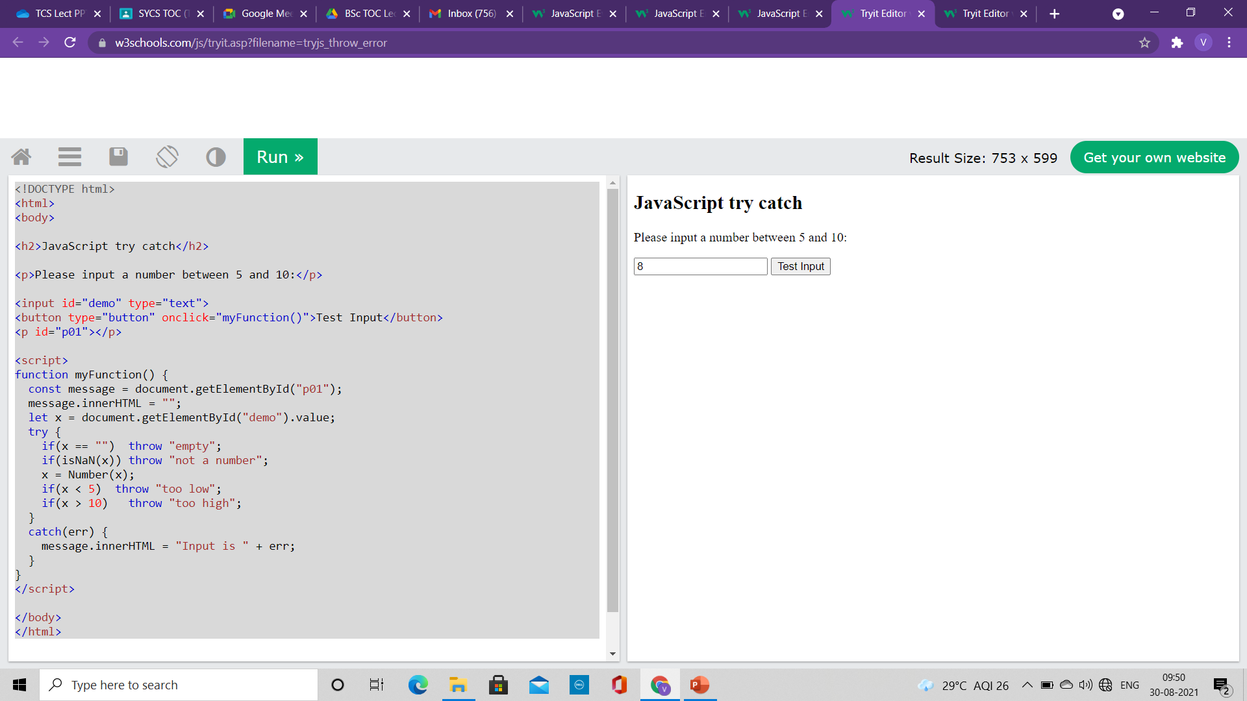


Input Validation
This example examines input. If the value is wrong, an exception (err) is thrown.
The exception (err) is caught by the catch statement and a custom error message is displayed:
<!DOCTYPE html>
<html>
<body>
<h2>JavaScript try catch</h2>
<p>Please input a number between 5 and 10:</p>
<input id="demo" type="text">
<button type="button" onclick="myFunction()">Test Input</button>
<p id="p01"></p>
<script>
function myFunction() {
const message = document.getElementById("p01");
message.innerHTML = "";
let x = document.getElementById("demo").value;
try {
if(x == "") throw "empty";
if(isNaN(x)) throw "not a number";
x = Number(x);
if(x < 5) throw "too low";
if(x > 10) throw "too high";
}
catch(err) {
message.innerHTML = "Input is " + err;
}
}
</script>
</body>
</html>

Slide 130
finally statement
<!DOCTYPE html>
<html>
<body>
<h2>JavaScript try catch</h2>
<p>Please input a number between 5 and 10:</p>
<input id="demo" type="text">
<button type="button" onclick="myFunction()">Test Input</button>
<p id="p01"></p>
<script>
function myFunction() {
const message = document.getElementById("p01");
message.innerHTML = "";
let x = document.getElementById("demo").value;
try {
if(x == "") throw "is empty";
if(isNaN(x)) throw "is not a number";
x = Number(x);
if(x > 10) throw "is too high";
if(x < 5) throw "is too low";
}
catch(err) {
message.innerHTML = "Input " + err;
}
finally {
document.getElementById("demo").value = "";
}
}
</script>
</body>
</html>
The finally statement lets you execute code, after try and catch, regardless of the result:
Syntax
try {
Block of code to try
}
catch(err) {
Block of code to handle errors
}
finally {
Block of code to be executed regardless of the try / catch result
}

Slide 131
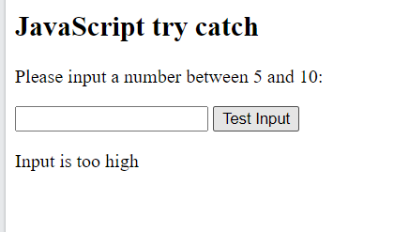
finally statement
<!DOCTYPE html>
<html>
<body>
<h2>JavaScript try catch</h2>
<p>Please input a number between 5 and 10:</p>
<input id="demo" type="text">
<button type="button" onclick="myFunction()">Test Input</button>
<p id="p01"></p>
<script>
function myFunction() {
const message = document.getElementById("p01");
message.innerHTML = "";
let x = document.getElementById("demo").value;
try {
if(x == "") throw "is empty";
if(isNaN(x)) throw "is not a number";
x = Number(x);
if(x > 10) throw "is too high";
if(x < 5) throw "is too low";
}
catch(err) {
message.innerHTML = "Input " + err;
}
finally {
document.getElementById("demo").value = "";
}
}
</script>
</body>
</html>

Slide 132
The Error Object
JavaScript has a built in error object that provides error information when an error occurs.
The error object provides two useful properties: name and message.
Error Object Properties
Property Description
name Sets or returns an error name
message Sets or returns an error message (a string)
Error Name Values

Slide 133
The Error Object
Error Name Values
Six different values can be returned by the error name property:
Error Name Description
EvalError An error has occurred in the eval() function
RangeError A number "out of range" has occurred
ReferenceError An illegal reference has occurred
SyntaxError A syntax error has occurred
TypeError A type error has occurred
URIError An error in encodeURI() has occurred

Slide 134
DOM (Document Object Model)

Slide 135

DOM (Document Object Model)
With the HTML DOM, JavaScript can access and change all the elements of an HTML document.
When a web page is loaded, the browser creates a Document Object Model of the page.
The HTML DOM model is constructed as a tree of Objects:

Slide 136
DOM (Document Object Model)
With the object model, JavaScript gets all the power it needs to create dynamic HTML:
JavaScript can
Change all the HTML elements in the page
Change all the HTML attributes in the page
Change all the CSS styles in the page
Remove existing HTML elements and attributes
Add new HTML elements and attributes
Can react to all existing HTML events in the page
Create new HTML events in the page

Slide 137
What is DOM (Document Object Model)
The DOM is a W3C (World Wide Web Consortium) standard.
The DOM defines a standard for accessing documents:
"The W3C Document Object Model (DOM) is a platform and language-neutral interface that allows programs and scripts to dynamically access and update the content, structure, and style of a document."
The W3C DOM standard is separated into 3 different parts:
Core DOM - standard model for all document types
XML DOM - standard model for XML documents
HTML DOM - standard model for HTML documents

Slide 138
What is HTML DOM?
The HTML DOM is a standard object model and programming interface for HTML.
It defines:
The HTML elements as objects
The properties of all HTML elements
The methods to access all HTML elements
The events for all HTML elements
In other words: The HTML DOM is a standard for how to get, change, add, or delete HTML elements.

Slide 139
DOM Nodes
According to the W3C HTML DOM standard, everything in an HTML document is a node:
The entire document is a document node
Every HTML element is an element node
The text inside HTML elements are text nodes
Every HTML attribute is an attribute node (deprecated)
All comments are comment nodes
With the HTML DOM, all nodes in the node tree can be accessed by JavaScript.
New nodes can be created, and all nodes can be modified or deleted.

Slide 140
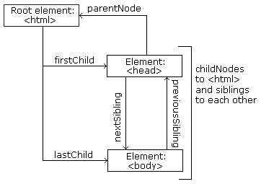
Node Relationships
The nodes in the node tree have a hierarchical relationship to each other.
The terms parent, child, and sibling are used to describe the relationships.
In a node tree, the top node is called the root (or root node)
Every node has exactly one parent, except the root (which has no parent)
A node can have a number of children
Siblings (brothers or sisters) are nodes with the same parent
<html> <head> <title>DOM Tutorial</title> </head> <body> <h1>DOM Lesson one</h1> <p>Hello world!</p> </body> </html>

Slide 141
Node Relationships
From the HTML given we can read
<html> is the root node
<html> has no parents
<html> is the parent of <head> and <body>
<head> is the first child of <html>
<body> is the last child of <html>
<head> has one child: <title>
<title> has one child (a text node): "DOM Tutorial"
<body> has two children: <h1> and <p>
<h1> has one child: "DOM Lesson one"
<p> has one child: "Hello world!"
<h1> and <p> are siblings
<html> <head> <title>DOM Tutorial</title> </head> <body> <h1>DOM Lesson one</h1> <p>Hello world!</p> </body> </html>

Slide 142
Navigation between Nodes
<html> <head> <title>DOM Tutorial</title> </head> <body> <h1>DOM Lesson one</h1> <p>Hello world!</p> </body> </html>
We can use the following node properties to navigate between nodes with JavaScript:
parentNode
childNodes[nodenumber]
firstChild
lastChild
nextSibling
previousSibling

Slide 143
Form Validation

Slide 144
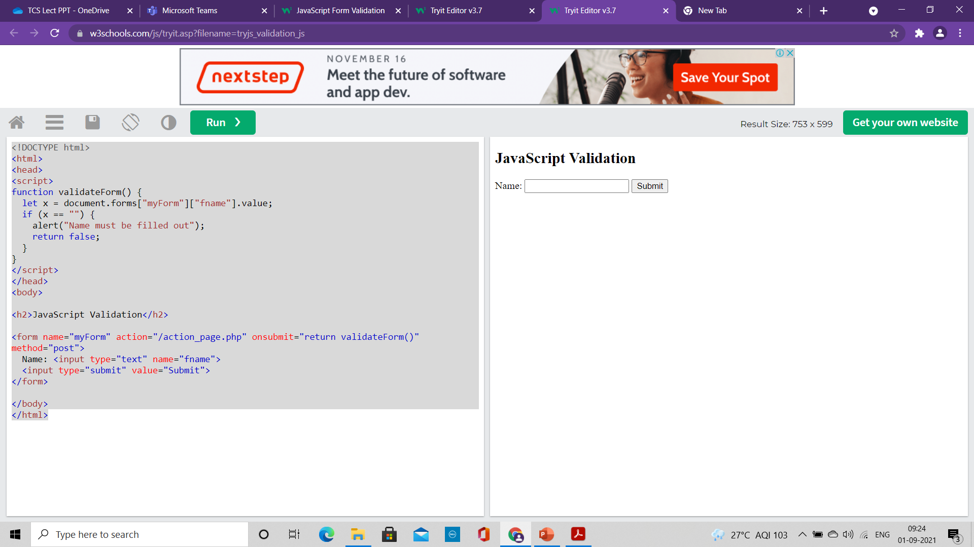
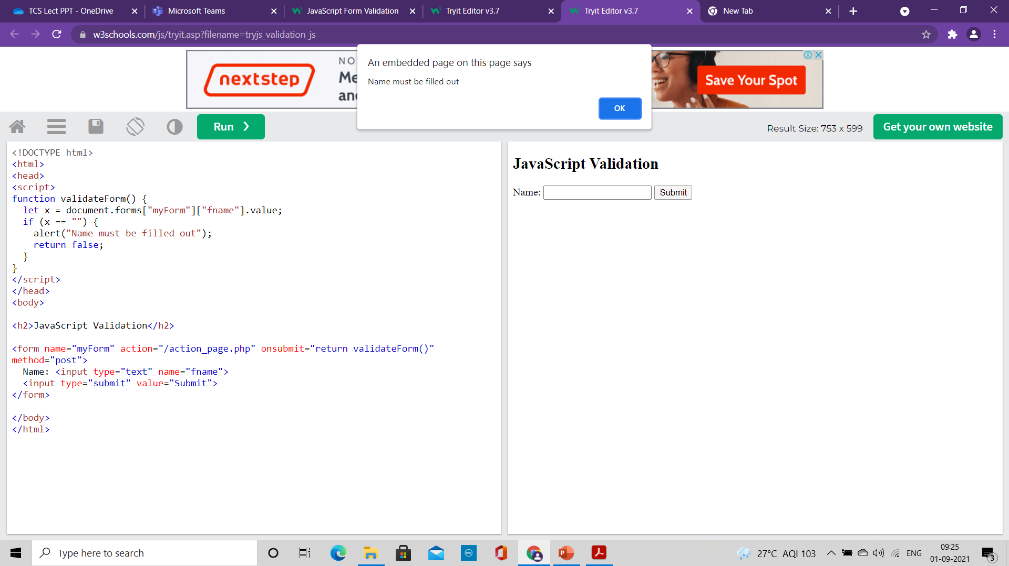
Form Validation
<!DOCTYPE html>
<html>
<head>
<script>
function validateForm() {
let x = document.forms["myForm"]["fname"].value;
if (x == "") {
alert("Name must be filled out");
return false;
}
}
</script>
</head>
<body>
<h2>JavaScript Validation</h2>
<form name="myForm" action="/action_page.php" onsubmit="return validateForm()" method="post">
Name: <input type="text" name="fname">
<input type="submit" value="Submit">
</form>
</body>
</html>
HTML form validation can be done by JavaScript.
If a form field (fname) is empty, this function alerts a message, and returns false, to prevent the form from being submitted
The function can be called when the form is submitted

Slide 145
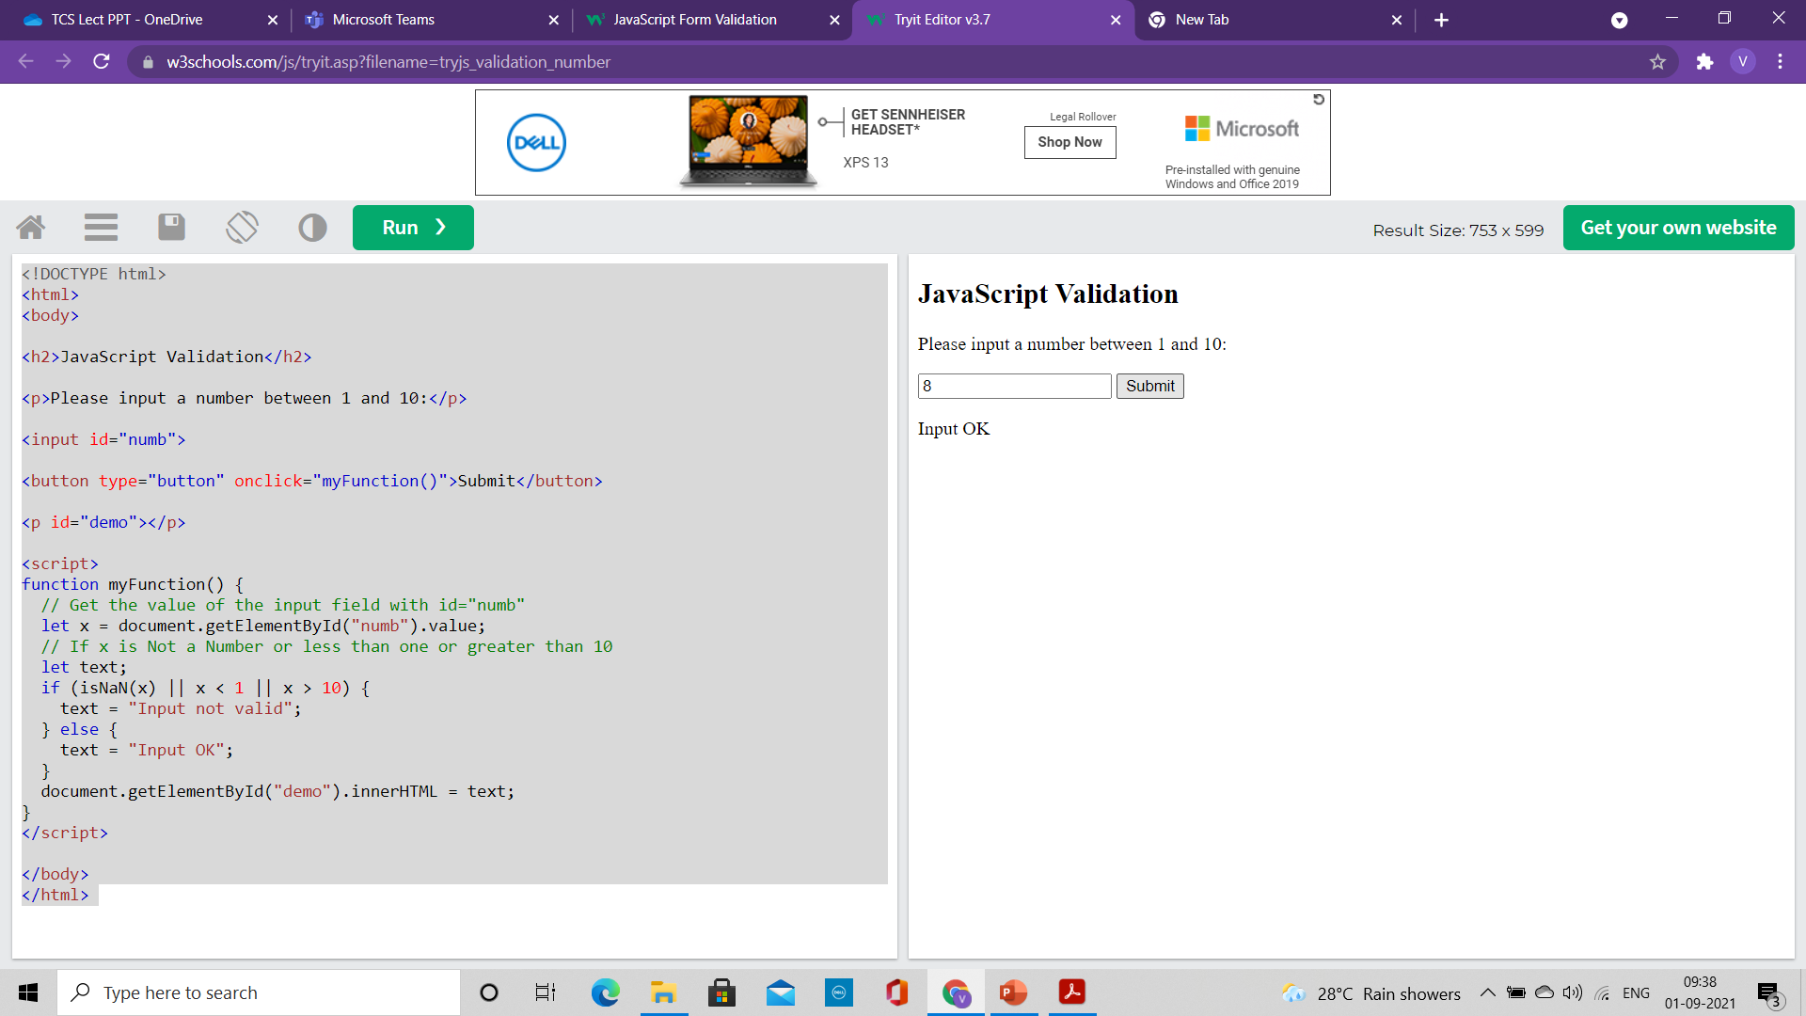

Form Validation
<!DOCTYPE html>
<html>
<body>
<h2>JavaScript Validation</h2>
<p>Please input a number between 1 and 10:</p>
<input id="numb">
<button type="button" onclick="myFunction()">Submit</button>
<p id="demo"></p>
<script>
function myFunction() {
// Get the value of the input field with id="numb"
let x = document.getElementById("numb").value;
// If x is Not a Number or less than one or greater than 10
let text;
if (isNaN(x) || x < 1 || x > 10) {
text = "Input not valid";
} else {
text = "Input OK";
}
document.getElementById("demo").innerHTML = text;
}
</script>
</body>
</html>
Validation of Numeric Inputs

Slide 146
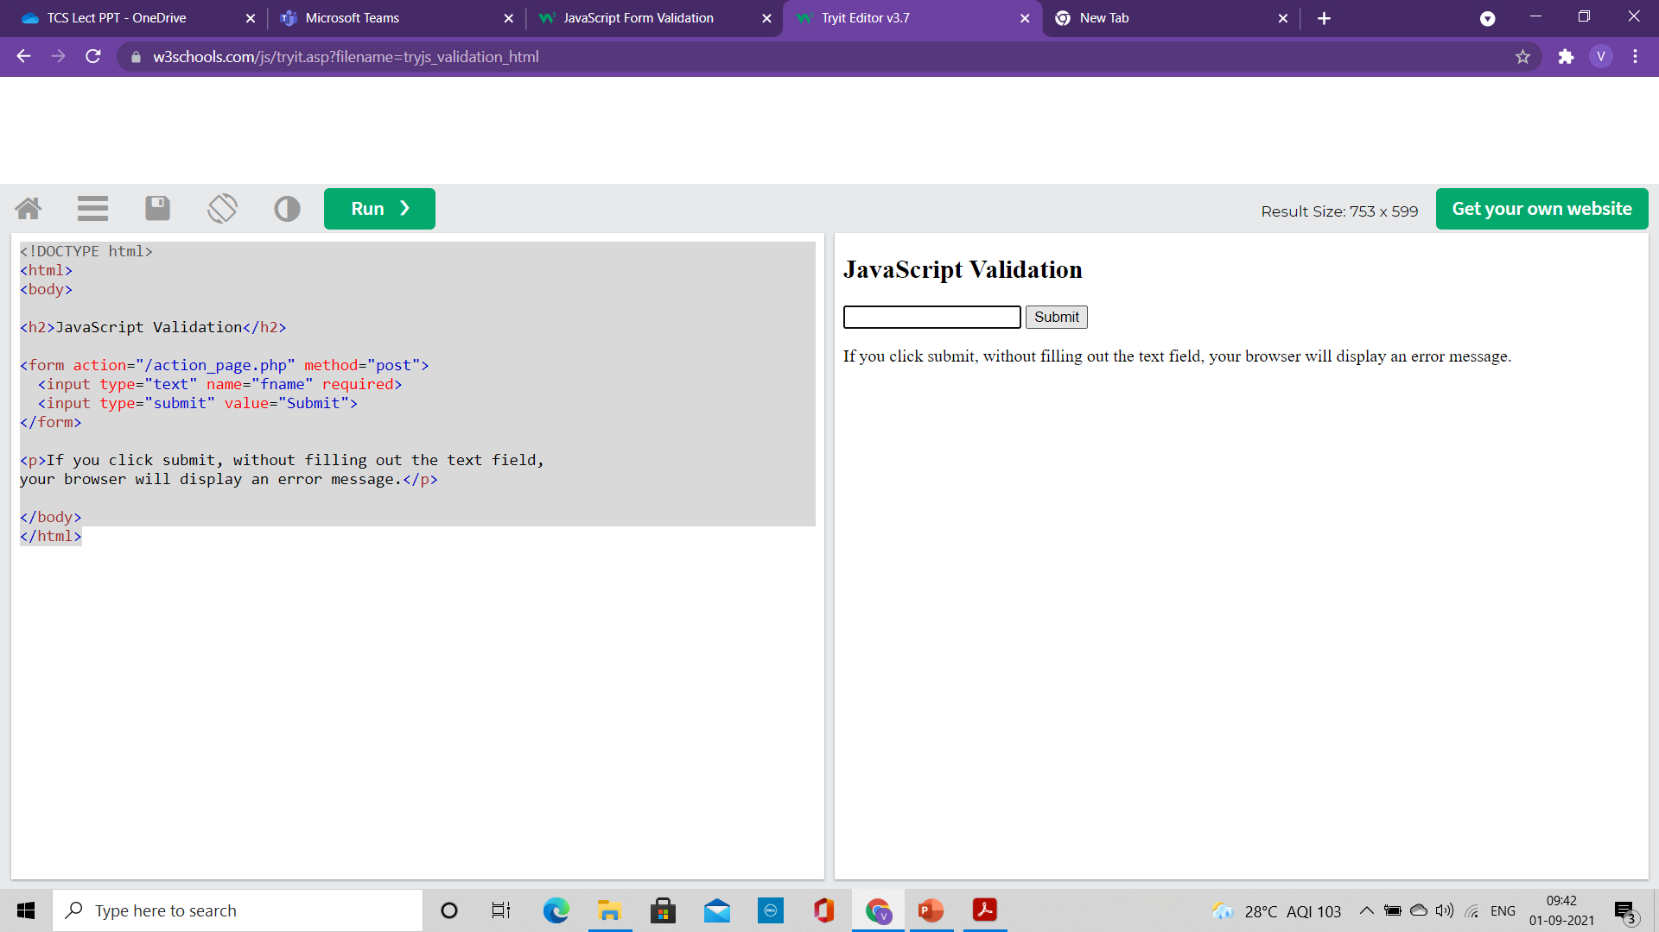

Automatic HTML Form Validation
HTML form validation can be performed automatically by the browser:
If a form field (fname) is empty, the required attribute prevents this form from being submitted
<!DOCTYPE html>
<html>
<body>
<h2>JavaScript Validation</h2>
<form action="/action_page.php" method="post">
<input type="text" name="fname" required>
<input type="submit" value="Submit">
</form>
<p>If you click submit, without filling out the text field,
your browser will display an error message.</p>
</body>
</html>

Slide 147
Data Validation
Data validation is the process of ensuring that user input is clean, correct, and useful.
Typical validation tasks are:
has the user filled in all required fields?
has the user entered a valid date?
has the user entered text in a numeric field?
Most often, the purpose of data validation is to ensure correct user input.
Validation can be defined by many different methods, and deployed in many different ways.
Server side validation: is performed by a web server, after input has been sent to the server.
Client side validation: is performed by a web browser, before input is sent to a web server.

Slide 148
Constraint Validation
HTML5 introduced a new HTML validation concept called constraint validation.
HTML constraint validation is based on:
Constraint validation HTML Input Attributes
Constraint validation CSS Pseudo Selectors
Constraint validation DOM Properties and Methods

Slide 149
Constraint Validation HTML Input Attributes
Attribute Description
disabled Specifies that the input element should be disabled
max Specifies the maximum value of an input element
min Specifies the minimum value of an input element
pattern Specifies the value pattern of an input element
required Specifies that the input field requires an element
type Specifies the type of an input element

Slide 150
Constraint Validation CSS Pseudo Selectors
Selector Description
:disabled Selects input elements with the "disabled" attribute specified
:invalid Selects input elements with invalid values
:optional Selects input elements with no "required" attribute specified
:required Selects input elements with the "required" attribute specified
:valid Selects input elements with valid values

Slide 151
DOM Events

Slide 152
JavaScript HTML DOM Events
HTML DOM allows JavaScript to react to HTML events
A JavaScript can be executed when an event occurs, like when a user clicks on an HTML element.
To execute code when a user clicks on an element, add JavaScript code to an HTML event attribute:
onclick=JavaScript
Examples of HTML events:
When a user clicks the mouse
When a web page has loaded
When an image has been loaded
When the mouse moves over an element
When an input field is changed
When an HTML form is submitted
When a user strokes a key

Slide 153
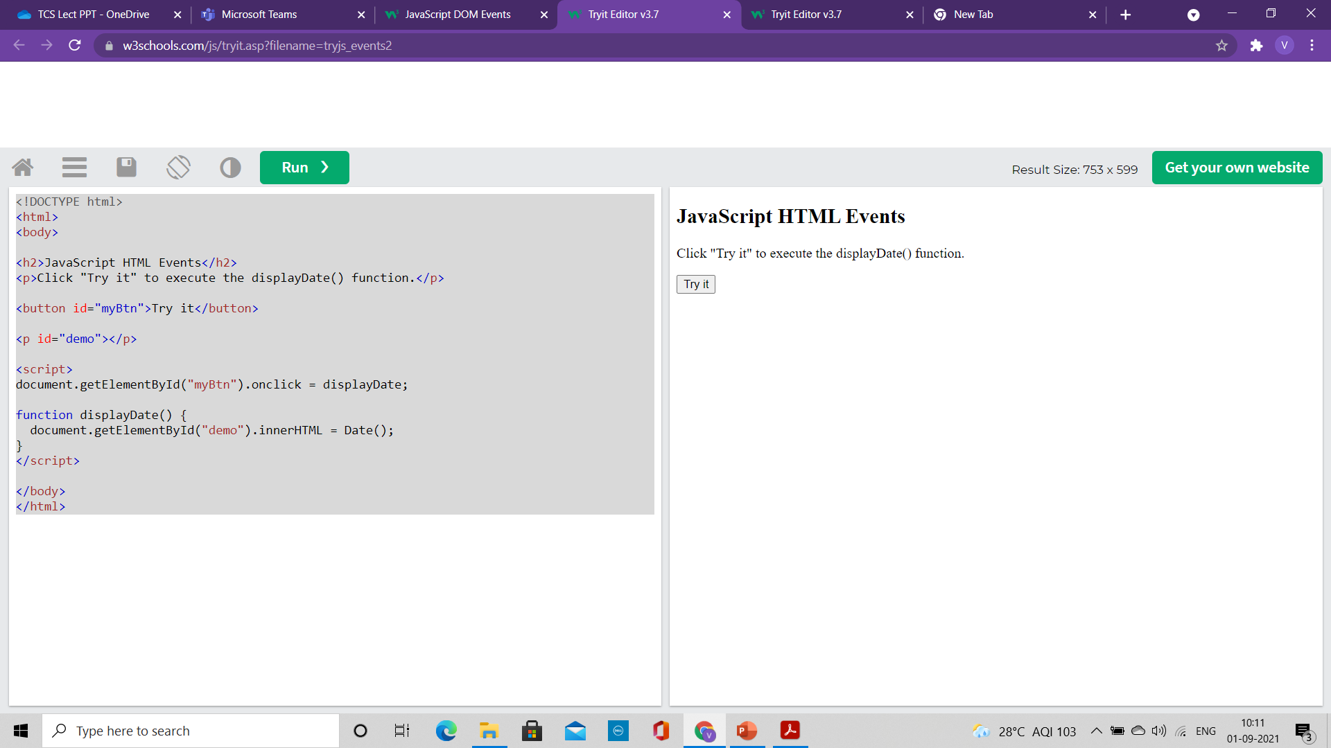
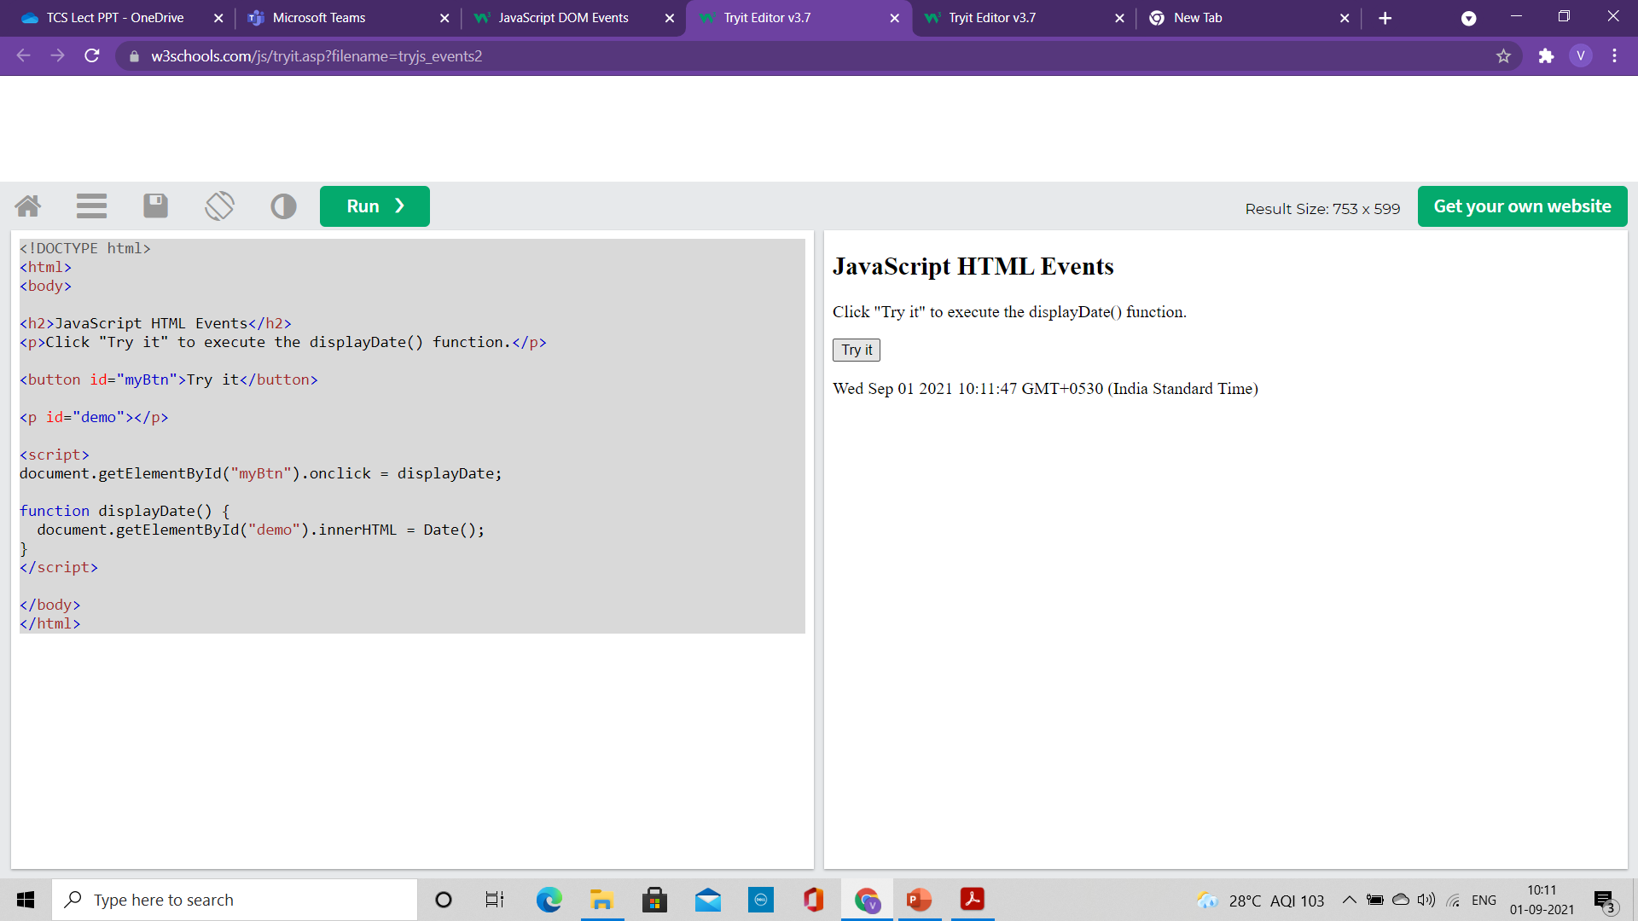
Assign events using HTML DOM
<!DOCTYPE html>
<html>
<body>
<h2>JavaScript HTML Events</h2>
<p>Click "Try it" to execute the displayDate() function.</p>
<button id="myBtn">Try it</button>
<p id="demo"></p>
<script>
document.getElementById("myBtn").onclick = displayDate;
function displayDate() {
document.getElementById("demo").innerHTML = Date();
}
</script>
</body>
</html>

Slide 154
Java Script
Module 2

Slide 155
Content
DOM Events
DOM Eventhandlers

Slide 156
DOM Events

Slide 157
JavaScript HTML DOM Events
HTML DOM allows JavaScript to react to HTML events
A JavaScript can be executed when an event occurs, like when a user clicks on an HTML element.
To execute code when a user clicks on an element, add JavaScript code to an HTML event attribute:
onclick=JavaScript
Examples of HTML events:
When a user clicks the mouse
When a web page has loaded
When an image has been loaded
When the mouse moves over an element
When an input field is changed
When an HTML form is submitted
When a user strokes a key

Slide 158
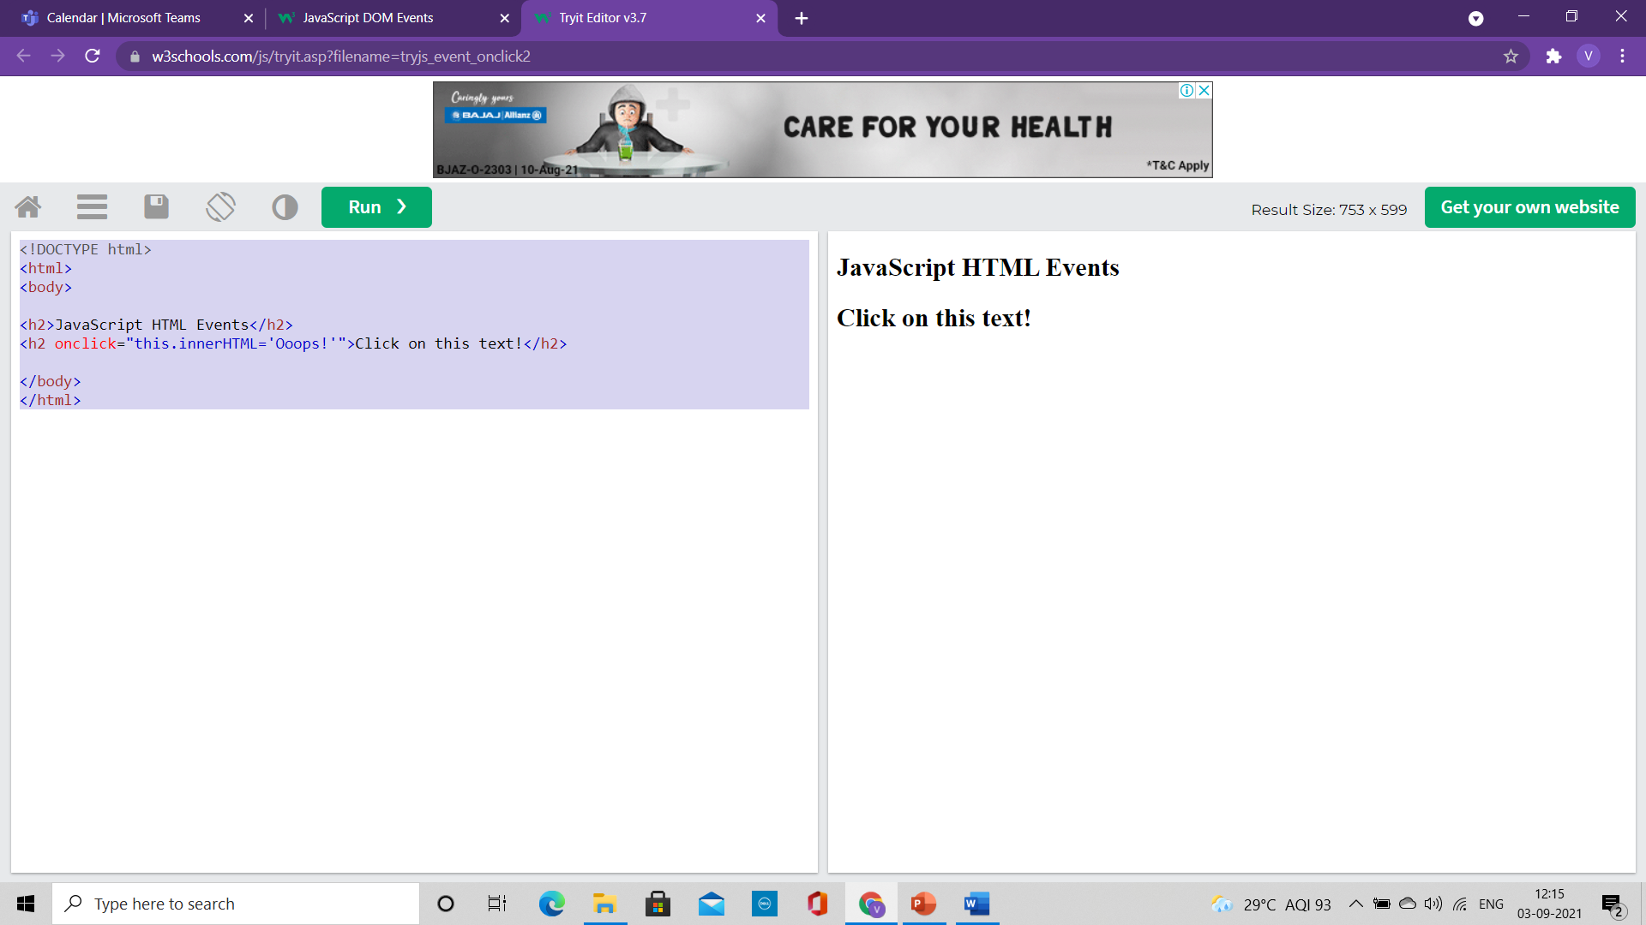

Changing Element with Click
<!DOCTYPE html>
<html>
<body>
<h2>JavaScript HTML Events</h2>
<h2 onclick="this.innerHTML='Ooops!'">Click on this text!</h2>
</body>
</html>
The content of the <h1> element is changed when a user clicks on it

Slide 159
Changing Element with Click
<!DOCTYPE html>
<html>
<body>
<h2>JavaScript HTML Events</h2>
<h2 onclick="changeText(this)">Click on this text!</h2>
<script>
function changeText(id) {
id.innerHTML = "Ooops!";
}
</script>
</body>
</html>
The content of the <h1> element is changed when a user clicks on it.
Here function is called from the event handler

Slide 160


Assign events using Element Attributes
<!DOCTYPE html>
<html>
<body>
<h2>JavaScript HTML Events</h2>
<p>Click the button to display the date.</p>
<button onclick="displayDate()">The time is?</button>
<script>
function displayDate() {
document.getElementById("demo").innerHTML = Date();
}
</script>
<p id="demo"></p>
</body>
</html>
To assign events to HTML elements you can use event attributes.
Assign an onclick event to a button element
For this example, a function named displayDate() will be executed when the button is clicked.

Slide 161
Assign events using HTML DOM
The HTML DOM allows you to assign events to HTML elements using JavaScript
In the example above, a function named displayDate is assigned to an HTML element with the id="myBtn"
<!DOCTYPE html>
<html>
<body>
<h2>JavaScript HTML Events</h2>
<p>Click "Try it" to execute the displayDate() function.</p>
<button id="myBtn">Try it</button>
<p id="demo"></p>
<script>
document.getElementById("myBtn").onclick = displayDate;
function displayDate() {
document.getElementById("demo").innerHTML = Date();
}
</script>
</body>
</html>

Slide 162

The onload and onunload Events
The onload and onunload events are triggered when the user enters or leaves the page.
The onload event:
Used to check the visitor's browser type and browser version
load the proper version of the web page based on the information.
The onload and onunload events can be used to deal with cookies.
<!DOCTYPE html>
<html>
<body onload="checkCookies()">
<h2>JavaScript HTML Events</h2>
<p id="demo"></p>
<script>
function checkCookies() {
var text = "";
if (navigator.cookieEnabled == true) {
text = "Cookies are enabled.";
} else {
text = "Cookies are not enabled.";
}
document.getElementById("demo").innerHTML = text;
}
</script>
</body>
</html>

Slide 163



The onchange Events
The onchange event is often used in combination with validation of input fields.
In the example
The upperCase() function will be called when a user changes the content of an input field.
<!DOCTYPE html>
<html>
<body>
<h2>JavaScript HTML Events</h2>
Enter your name: <input type="text" id="fname" onchange="upperCase()">
<p>When you leave the input field, a function is triggered which transforms the input text to upper case.</p>
<script>
function upperCase() {
const x = document.getElementById("fname");
x.value = x.value.toUpperCase();
}
</script>
</body>
</html>

Slide 164


The Mouse Events
<!DOCTYPE html>
<html>
<body>
<div onmouseover="mOver(this)" onmouseout="mOut(this)"
style="background-color:#D94A38;width:120px;height:20px;padding:40px;">
Mouse Over Me</div>
<script>
function mOver(obj) {
obj.innerHTML = "Thank You"
}
function mOut(obj) {
obj.innerHTML = "Mouse Over Me"
}
</script>
</body>
</html>
The onmouseover event
The onmouseout events
They can be used to trigger a function when the user mouses over, or out of, an HTML element

Slide 165



The Mouse Events
<!DOCTYPE html>
<html>
<body>
<div onmousedown="mDown(this)" onmouseup="mUp(this)"
style="background-color:#D94A38;width:90px;height:20px;padding:40px;">
Click Me</div>
<script>
function mDown(obj) {
obj.style.backgroundColor = "#1ec5e5";
obj.innerHTML = "Release Me";
}
function mUp(obj) {
obj.style.backgroundColor="#D94A38";
obj.innerHTML="Thank You";
}
</script>
</body>
</html>
onmousedown event: when a mouse-button is clicked, the onmousedown event is triggered
onmouseup event: when the mouse-button is released, the onmouseup event is triggered
onclick event: when the mouse-click is completed, the onclick event is triggered

Slide 166


The onfocus Events
<!DOCTYPE html>
<html>
<head>
<script>
function myFunction(x) {
x.style.background = "yellow";
}
</script>
</head>
<body>
Enter your name: <input type="text" onfocus="myFunction(this)">
<p>When the input field gets focus, a function is triggered which changes the background-color.</p>
</body>
</html>
onfocus event: Change the background-color of an input field when it gets focus.

Slide 167
DOM EventListener

Slide 168
The addEventListener() method
It attaches an event handler to the specified element.
It attaches an event handler to an element without overwriting existing event handlers.
We can add many event handlers to one element.
We can add many event handlers of the same type to one element, i.e two "click" events.
We can add event listeners to any DOM object not only HTML elements. i.e the window object.
The addEventListener() method makes it easier to control how the event reacts to bubbling.
When using the addEventListener() method, the JavaScript is separated from the HTML markup, for better readability and allows you to add event listeners even when you do not control the HTML markup.
We can easily remove an event listener by using the removeEventListener() method.

Slide 169
The addEventListener() method
Syntax:
element.addEventListener(event, function, useCapture);
The first parameter is the type of the event (like "click" or "mousedown" or any other HTML DOM Event.)
The second parameter is the function we want to call when the event occurs.
The third parameter is a boolean value specifying whether to use event bubbling or event capturing. This parameter is optional.
Note that you don't use the "on" prefix for the event; use "click" instead of "onclick".

Slide 170


Example
<!DOCTYPE html>
<html>
<body>
<h2>JavaScript addEventListener()</h2>
<p>This example uses the addEventListener() method to attach a click event to a button.</p>
<button id="myBtn">Try it</button>
<script>
document.getElementById("myBtn").addEventListener("click", function() {
alert("Hello World!");
});
</script>
</body>
</html>

Slide 171


Example
<!DOCTYPE html>
<html>
<body>
<h2>JavaScript addEventListener()</h2>
<p>This example uses the addEventListener() method to attach a click event to a button.</p>
<button id="myBtn">Try it</button>
<p id="demo"></p>
<script>
document.getElementById("myBtn").addEventListener("click", displayDate);
function displayDate() {
document.getElementById("demo").innerHTML = Date();
}
</script>
</body>
</html>
Here external function displaydate( ) is written.

Slide 172



Many Event Handler to same element
<!DOCTYPE html>
<html>
<body>
<h2>JavaScript addEventListener()</h2>
<p>This example uses the addEventListener() method to add two click events to the same button.</p>
<button id="myBtn">Try it</button>
<script>
var x = document.getElementById("myBtn");
x.addEventListener("click", myFunction);
x.addEventListener("click", someOtherFunction);
function myFunction() {
alert ("Hello World!");
}
function someOtherFunction() {
alert ("This function was also executed!");
}
</script>
</body>
</html>
Two events are defined for button click

Slide 173


Many Event Handler to same element
<!DOCTYPE html>
<html>
<body>
<h2>JavaScript addEventListener()</h2>
<p>This example uses the addEventListener() method to add many events on the same button.</p>
<button id="myBtn">Try it</button>
<p id="demo"></p>
<script>
var x = document.getElementById("myBtn");
x.addEventListener("mouseover", myFunction);
x.addEventListener("click", mySecondFunction);
x.addEventListener("mouseout", myThirdFunction);
function myFunction() {
document.getElementById("demo").innerHTML += "Moused over!<br>";
}
function mySecondFunction() {
document.getElementById("demo").innerHTML += "Clicked!<br>";
}
function myThirdFunction() {
document.getElementById("demo").innerHTML += "Moused out!<br>";
}
</script>
</body>
</html>
You can add events of different types to the same element

Slide 174


Passing Parameters
When passing parameter values, use an "anonymous function" that calls the specified function with the parameters
<!DOCTYPE html>
<html>
<body>
<h2>JavaScript addEventListener()</h2>
<p>This example demonstrates how to pass parameter values when using the addEventListener() method.</p>
<p>Click the button to perform a calculation.</p>
<button id="myBtn">Try it</button>
<p id="demo"></p>
<script>
let p1 = 5;
let p2 = 7;
document.getElementById("myBtn").addEventListener("click", function() {
myFunction(p1, p2);
});
function myFunction(a, b) {
document.getElementById("demo").innerHTML = a * b;
}
</script>
</body>
</html>

Slide 175
Event Bubbling or Event Capturing?
There are two ways of event propagation in the HTML DOM
Bubbling: In bubbling the inner most element's event is handled first and then the outer
Capturing: In capturing the outer most element's event is handled first and then the inner
Event propagation is a way of defining the element order when an event occurs.
If you have a <p> element inside a <div> element, and the user clicks on the <p> element, which element's "click" event should be handled first?
In bubbling: the <p> element's click event is handled first, then the <div> element's click event.
In capturing: the <div> element's click event will be handled first, then the <p> element's click event.

Slide 176
Event Bubbling or Event Capturing?
Syntax:
With the addEventListener() method we can specify the propagation type by using the "useCapture" parameter:
addEventListener(event, function, useCapture);
The default value is false, which will use the bubbling propagation,
when the value is set to true, the event uses the capturing propagation.

Slide 177
Event Bubbling and Event Capturing
<!DOCTYPE html>
<html>
<head>
<style>
#myDiv1, #myDiv2 {
background-color: coral;
padding: 50px;
}
#myP1, #myP2 {
background-color: white;
font-size: 20px;
border: 1px solid;
padding: 20px;
}
</style>
<meta content="text/html; charset=utf-8" http-equiv="Content-Type">
</head>
<body>
<h2>JavaScript addEventListener()</h2>
<div id="myDiv1">
<h2>Bubbling:</h2>
<p id="myP1">Click me!</p>
</div><br>
<div id="myDiv2">
<h2>Capturing:</h2>
<p id="myP2">Click me!</p>
</div>
<script>
document.getElementById("myP1").addEventListener("click", function() {
alert("You clicked the white element!");
}, false);
document.getElementById("myDiv1").addEventListener("click", function() {
alert("You clicked the orange element!");
}, false);
document.getElementById("myP2").addEventListener("click", function() {
alert("You clicked the white element!");
}, true);
document.getElementById("myDiv2").addEventListener("click", function() {
alert("You clicked the orange element!");
}, true);
</script>
</body>
</html>

Slide 178

Event Bubbling and Event Capturing
<script>
document.getElementById("myP1").addEventListener("click", function() {
alert("You clicked the white element!");
}, false);
document.getElementById("myDiv1").addEventListener("click", function() {
alert("You clicked the orange element!");
}, false);
document.getElementById("myP2").addEventListener("click", function() {
alert("You clicked the white element!");
}, true);
document.getElementById("myDiv2").addEventListener("click", function() {
alert("You clicked the orange element!");
}, true);
</script>
</body>
</html>

Slide 179

The removeEventListener() method
It removes event handlers that have been attached with the addEventListener() method:
<!DOCTYPE html>
<html>
<head>
<style>
#myDIV {
background-color: coral; border: 1px solid; padding: 50px; color: white; font-size: 20px;
}
</style>
</head>
<body>
<h2>JavaScript removeEventListener()</h2>
<div id="myDIV">
<p>This div element has an onmousemove event handler that displays a random number every time you move your mouse inside this orange field.</p>
<p>Click the button to remove the div's event handler.</p>
<button onclick="removeHandler()" id="myBtn">Remove</button>
</div>
<p id="demo"></p>
<script>
document.getElementById("myDIV").addEventListener("mousemove", myFunction);
function myFunction() {
document.getElementById("demo").innerHTML = Math.random();
}
function removeHandler() {
document.getElementById("myDIV").removeEventListener("mousemove", myFunction);
}
</script>
</body>
</html>

